Slide 1
NETWORK ANALYSIS
AND
SYNTHESIS

Slide 2
CHAPTER 3
NETWORK FUNCTIONS

Slide 3
TERMINAL PAIRS OR PORT
Consider an arbitrary network made up entirely of passive elements; such as resistors, inductors and capacitors.
If a conductor is fastened to any node in the network and brought out of the box for access, the end of this conductor is designated as a terminal.
Terminals are required for:
      Connecting driving force to the network
      Connecting some other network (say, load) or
      Making measurement
The minimum number of terminals that are useful is two (one port).

Slide 4
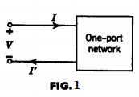
Cont …
Terminals are associated in pairs: one pair for a driving force, another pair for the load, etc.
A port may be regarded as a pair of terminals in which the current into one terminal equals the current out of the other.
For the one-port network shown in Fig. 1, I=I'.
A one-port network is completely specified when the voltage-
current relationship at the terminals of the port is given.
The pair of terminals in a one port network is customarily connected to an energy source (driving force) for the network, called driving point of the network.
We have 2-port network, generally, n-port network.

Slide 5
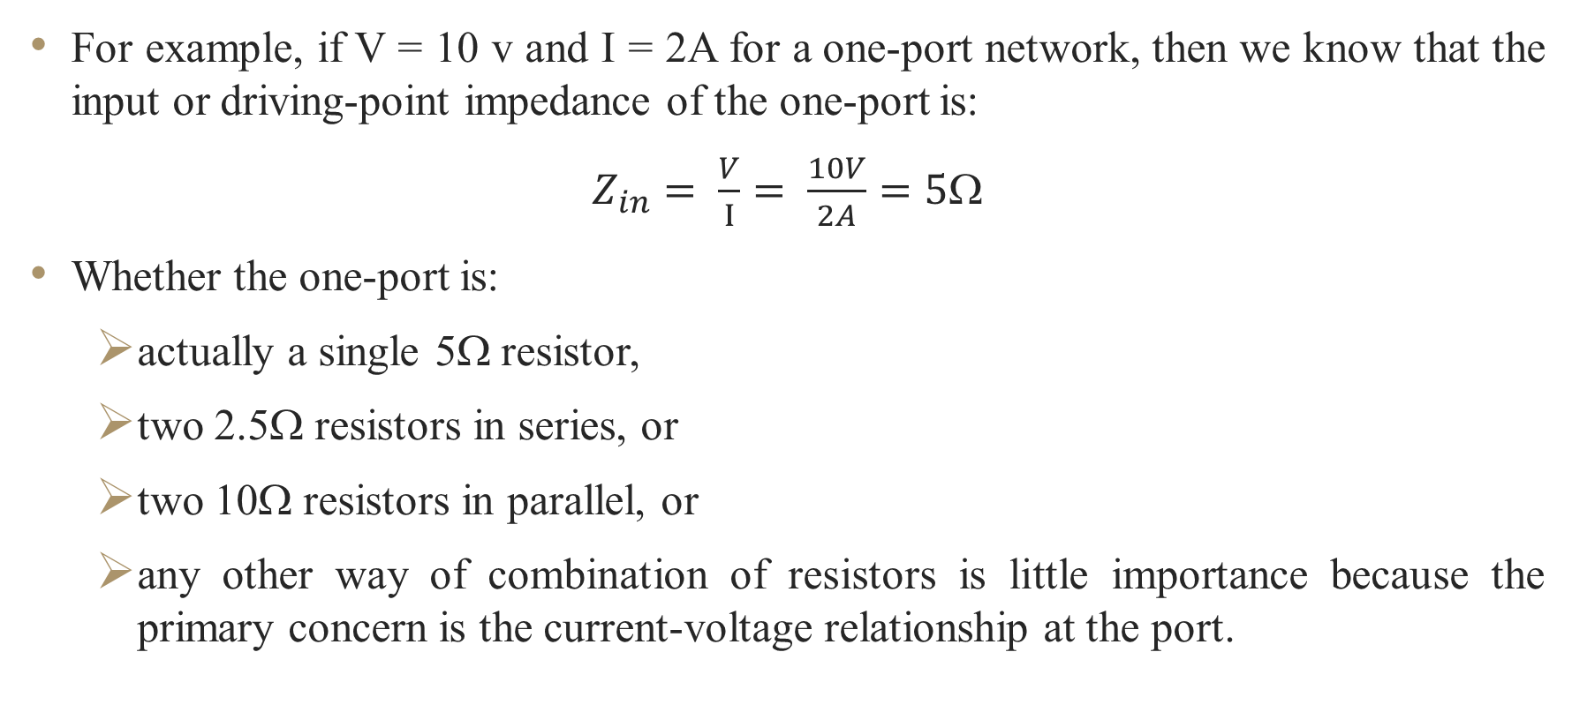
Cont …
For example, if V = 10 v and I = 2A for a one-port network, then we know that the input or driving-point impedance of the one-port is:
$Z_{in}= \frac{V}{I}= \frac{10V}{2A}=5Ω$
Whether the one-port is:
  actually a single 5Ω resistor,
  two 2.5Ω resistors in series, or
  two 10Ω resistors in parallel, or
  any other way of combination of resistors is little importance because the primary concern is the current-voltage relationship at the port.

Slide 6
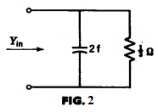
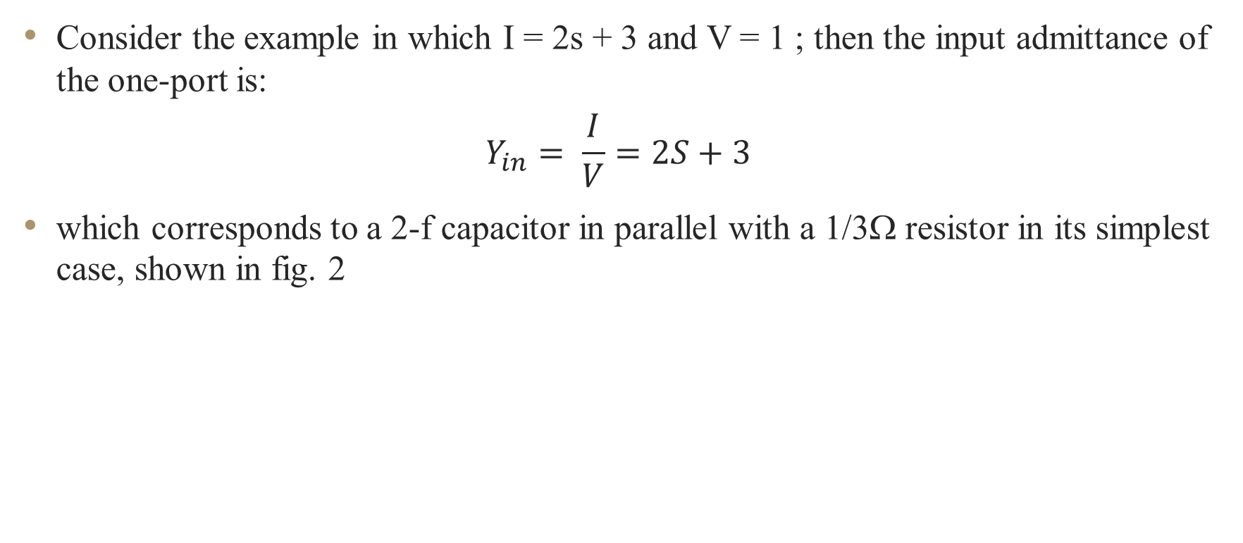
Cont …
Consider the example in which I = 2s + 3 and V = 1 ; then the input admittance of the one-port is:
$$Y_{in}= \frac{I}{V}=2S+3$$
which corresponds to a 2-f capacitor in parallel with a 1/3Ω resistor in its simplest case, shown in fig. 2

Slide 7
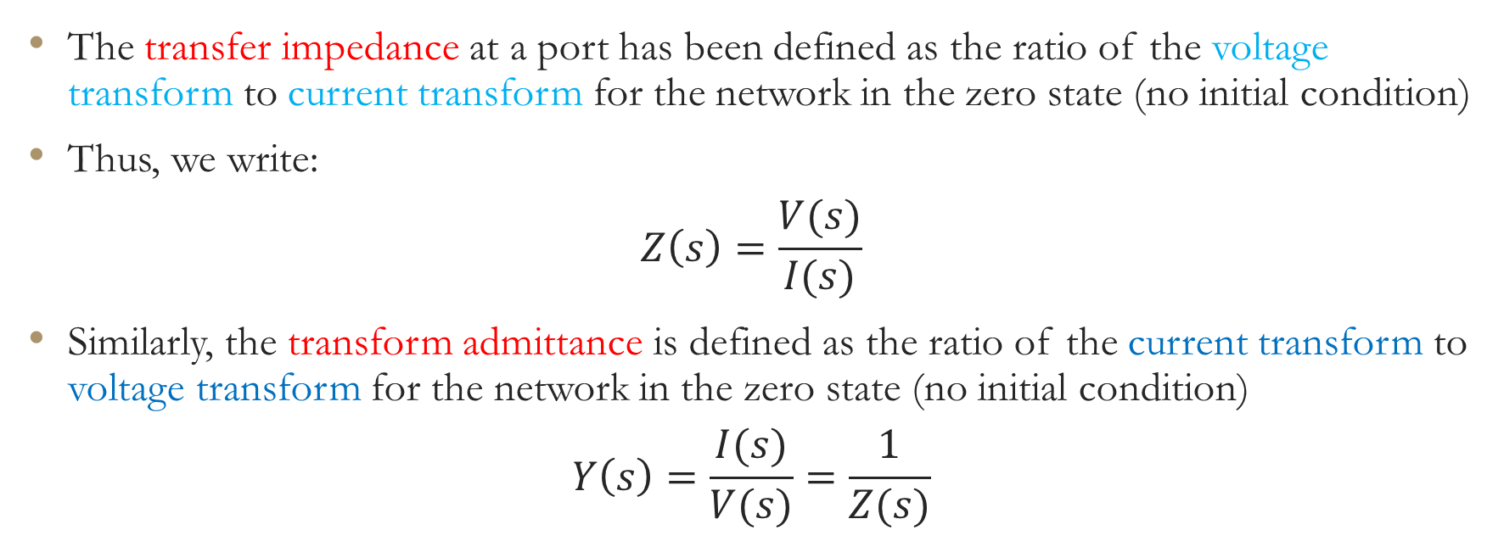
NETWORK FUNCTIONS
FOR THE ONE PORT AND TWO PORT
The transfer impedance at a port has been defined as the ratio of the voltage transform to current transform for the network in the zero state (no initial condition)
Thus, we write:
$$Z\left(s\right)=\frac{V(s)}{I(s)}$$
Similarly, the transform admittance is defined as the ratio of the current transform to voltage transform for the network in the zero state (no initial condition)
$$Y\left(s\right)=\frac{I(s)}{V(s)}=\frac{1}{Z(s)}$$

Slide 8
Cont …
If the transform voltage and current found at the same port; then the impedance or admittance is termed as a driving point impedance or admittance.
An immittance is a common name for impedance and admittance.
Transfer Function: related the transform of a quantity at one port to the transform of another quantity at another port.
Thus, transfer functions which relates voltages and currents have the following possible forms:
  The ratio of one voltage to another voltage, or the voltage transfer ratio.
  The ratio of one current to another current, or the current transfer ratio.
  The ratio of one voltage to another current, or the transfer impedance (transfer immittance).
  The ratio of one current to another voltage, or the transfer admittance (transfer immittance).

Slide 9
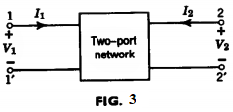
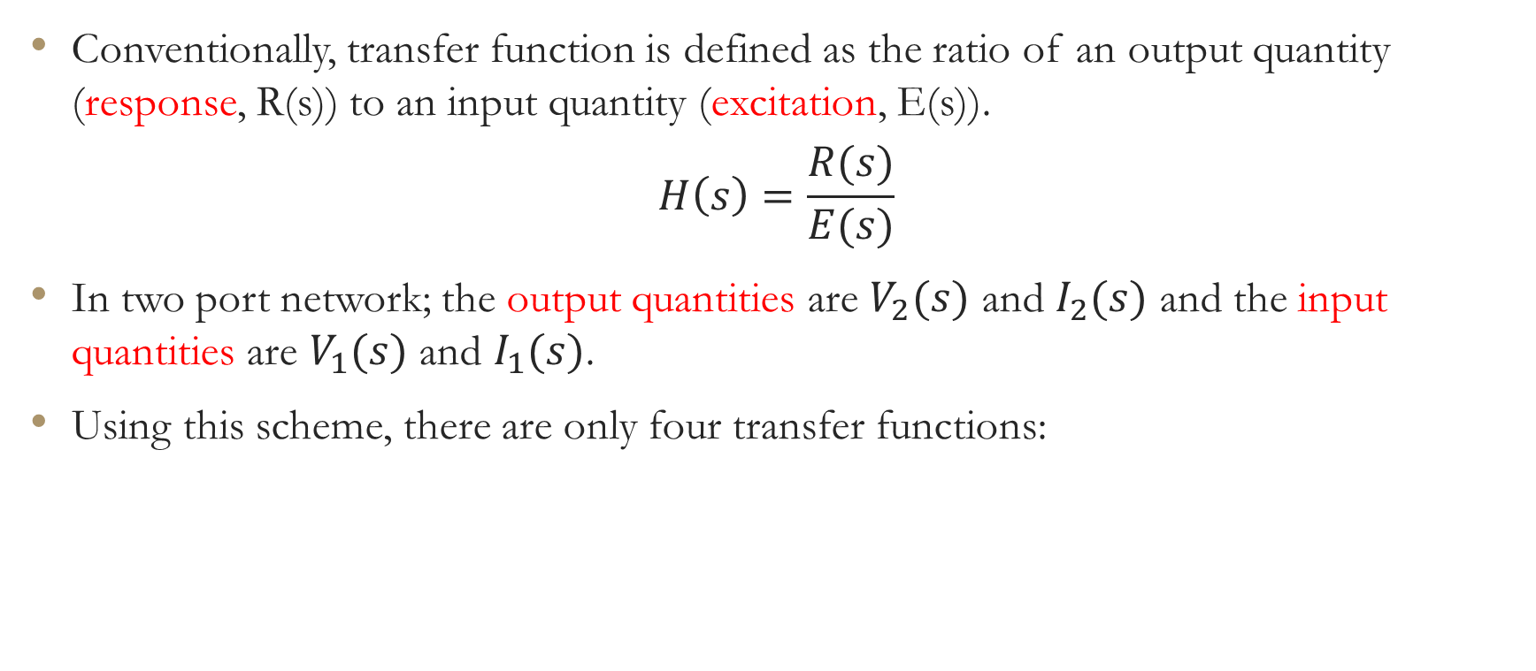
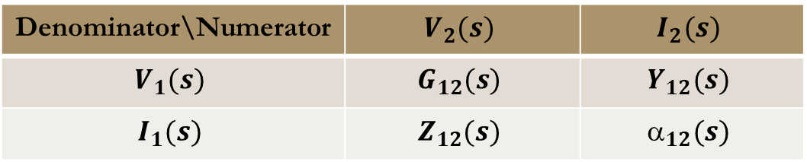
Cont …
Conventionally, transfer function is defined as the ratio of an output quantity (response, R(s)) to an input quantity (excitation, E(s)).
$$H\left(s\right)=\frac{R(s)}{E(s)}$$
In two port network; the output quantities are $V_{2}(s)$ and $I_{2}(s)$ and the input quantities are $V_{1}(s)$ and $I_{1}(s)$.
Using this scheme, there are only four transfer functions:
Denominator\Numerator | $$V_{2}(s)$$ | $$I_{2}(s)$$
$$V_{1}(s)$$ | $$G_{12}(s)$$ | $$Y_{12}(s)$$
$$I_{1}(s)$$ | $$Z_{12}(s)$$ | $$_{12}(s)$$

Slide 10
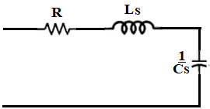
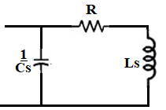
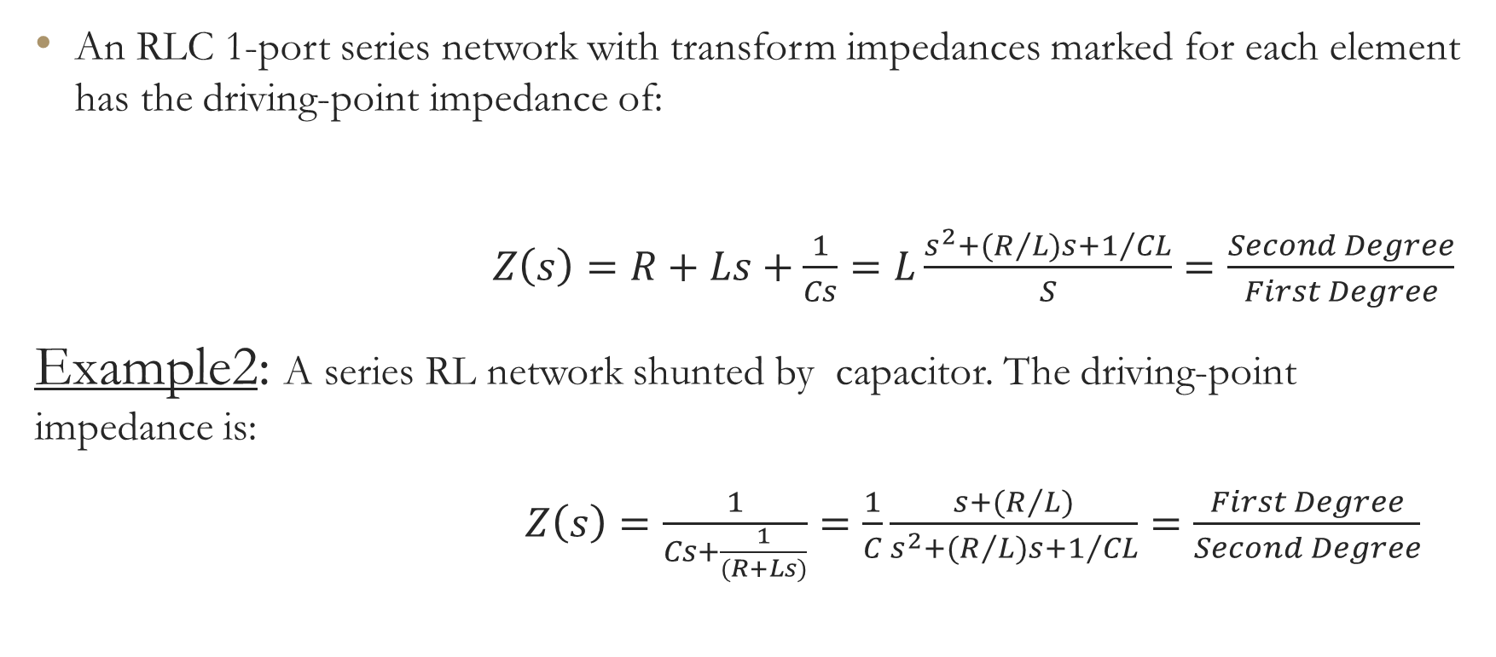
Example1:
An RLC 1-port series network with transform impedances marked for each element has the driving-point impedance of:
$Z\left(s\right)=R+Ls+\frac{1}{Cs}=L\frac{s^{2}+(R/{L)s+1/{CL}}}{S}=\frac{Second Degree}{First Degree}$
Example2: A series RL network shunted by capacitor. The driving-point impedance is:
$Z\left(s\right)=\frac{1}{Cs+\frac{1}{(R+Ls)}}=\frac{1}{C}\frac{s+{(R}/{L)}}{s^{2}+(R/{L)s}+1/{CL}}=\frac{First Degree}{Second Degree}$

Slide 11
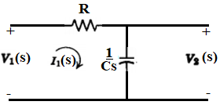
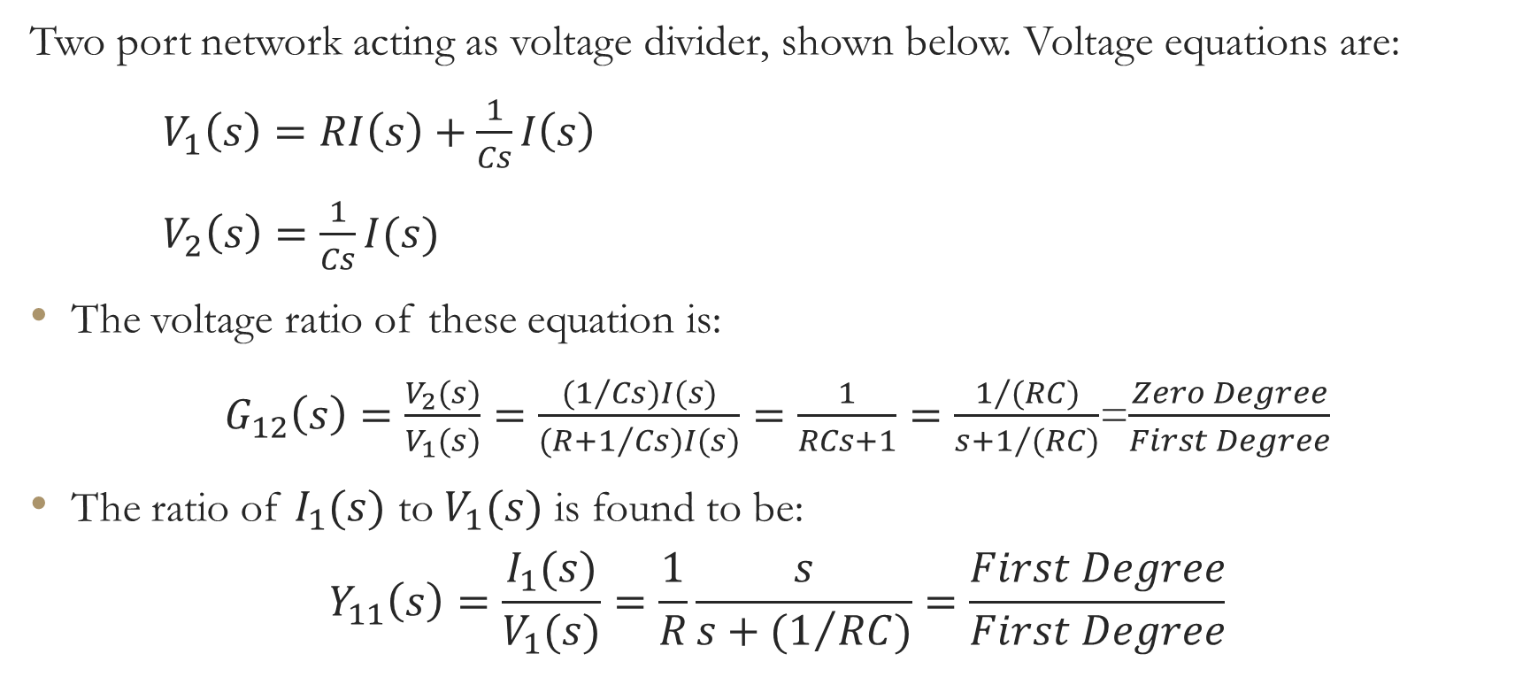
Example3:
Two port network acting as voltage divider, shown below. Voltage equations are:
$V_{1}\left(s\right)=RI\left(s\right)+\frac{1}{Cs}I\left(s\right)$
$V_{2}\left(s\right)=\frac{1}{Cs}I(s)$
The voltage ratio of these equation is:
$G_{12}\left(s\right)=\frac{V_{2}(s)}{V_{1}(s)}=\frac{(1/{Cs)}I(s)}{(R+1/{Cs)}I(s)}=\frac{1}{RCs+1}=\frac{1/{(RC)}}{s+1/{(RC)}}$=$\frac{Zero Degree}{First Degree}$
The ratio of $I_{1}(s)$ to $V_{1}(s)$ is found to be:
$$Y_{11}\left(s\right)=\frac{I_{1}(s)}{V_{1}(s)}=\frac{1}{R}\frac{s}{s+(1/{RC})}=\frac{First Degree}{First Degree}$$

Slide 12
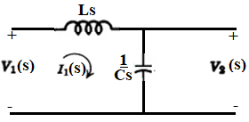
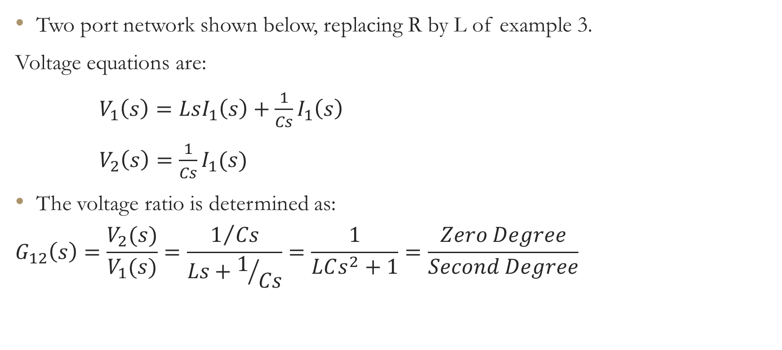
Example 4:
Two port network shown below, replacing R by L of example 3.
Voltage equations are:
$V_{1}\left(s\right)=LsI_{1}\left(s\right)+\frac{1}{Cs}I_{1}\left(s\right)$
$V_{2}\left(s\right)=\frac{1}{Cs}I_{1}(s)$
The voltage ratio is determined as:
$$G_{12}\left(s\right)=\frac{V_{2}(s)}{V_{1}(s)}=\frac{1/{Cs}}{Ls+1/{Cs}}=\frac{1}{LCs^{2}+1}=\frac{Zero Degree}{Second Degree}$$

Slide 13
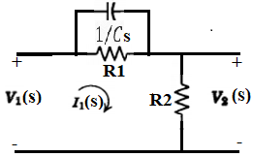
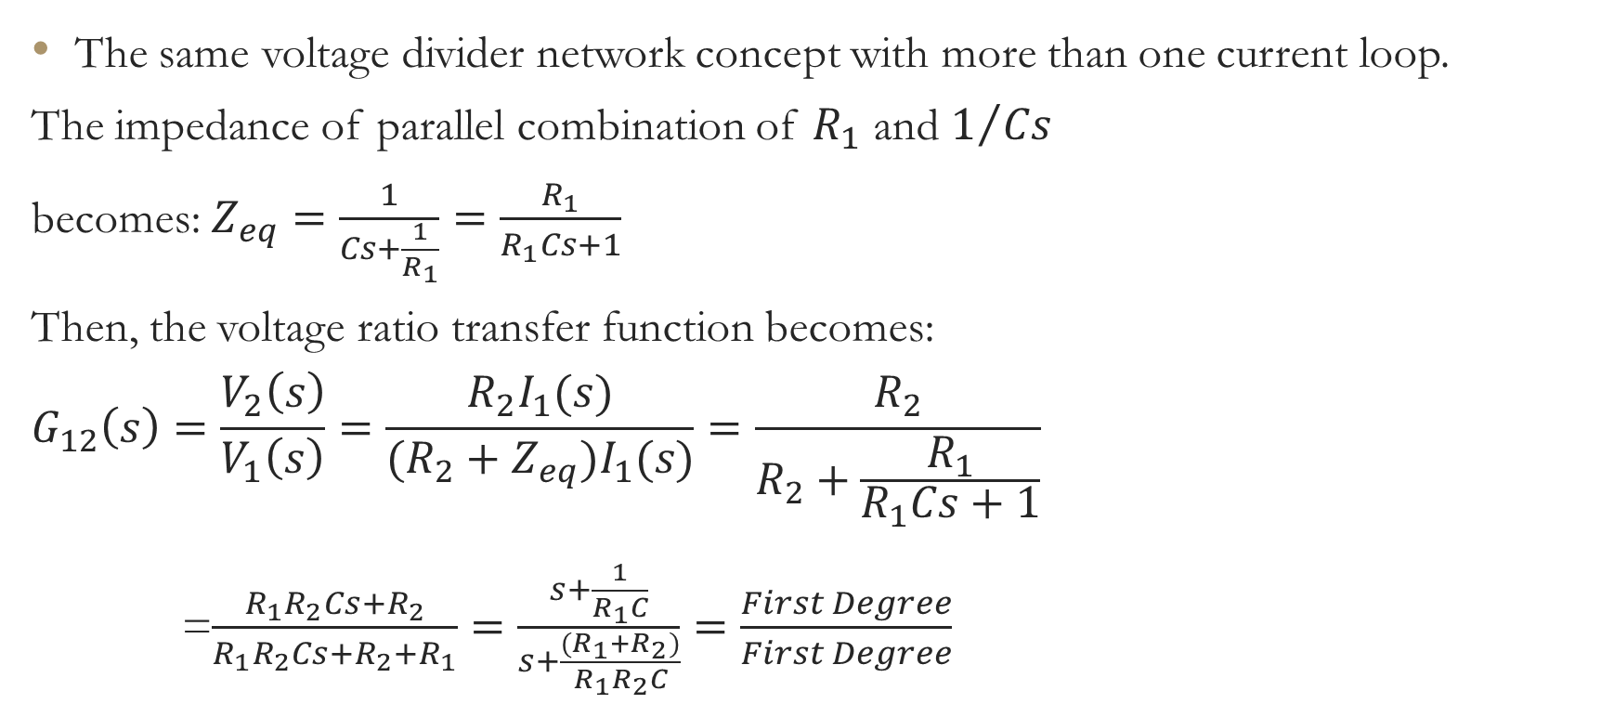
Example 5:
The same voltage divider network concept with more than one current loop.
The impedance of parallel combination of $R_{1}$ and $1/{Cs}$
becomes: $Z_{eq}=\frac{1}{Cs+\frac{1}{R_{1}}}=\frac{R_{1}}{R_{1}Cs+1}$
Then, the voltage ratio transfer function becomes:
$$G_{12}\left(s\right)=\frac{V_{2}\left(s\right)}{V_{1}\left(s\right)}=\frac{R_{2}I_{1}(s)}{(R_{2}+Z_{eq})I_{1}(s)}=\frac{R_{2}}{R_{2}+\frac{R_{1}}{R_{1}Cs+1}}$$
=$\frac{R_{1}R_{2}Cs+R_{2}}{R_{1}R_{2}Cs+R_{2}+R_{1}}=\frac{s+\frac{1}{R_{1}C}}{s+\frac{(R_{1}+R_{2})}{R_{1}R_{2}C}}=\frac{First Degree}{First Degree}$

Slide 14
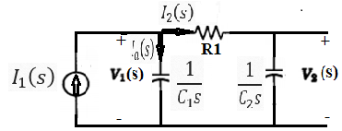
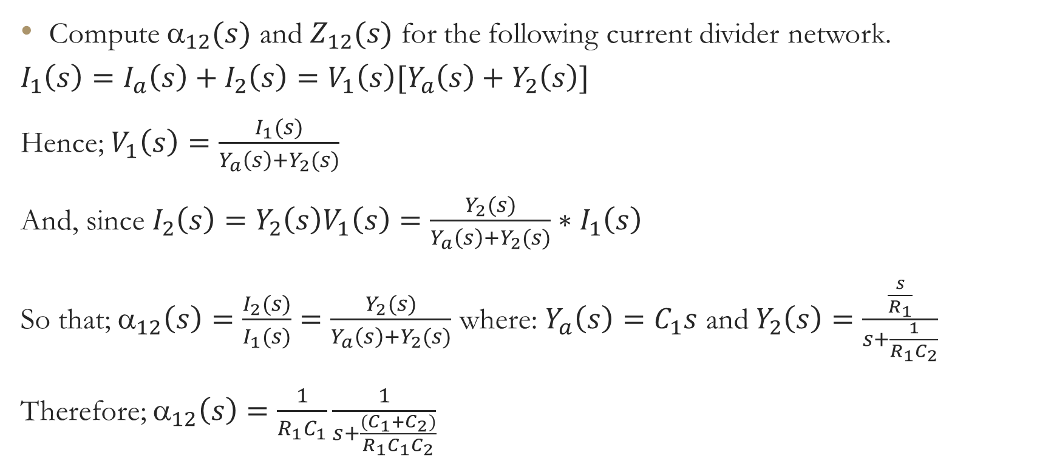
Example 6:
Compute $_{12}(s)$ and $Z_{12}(s)$ for the following current divider network.
$$I_{1}\left(s\right)=I_{a}\left(s\right)+I_{2}\left(s\right)=V_{1}\left(s\right)[Y_{a}\left(s\right)+Y_{2}\left(s\right)]$$
Hence; $V_{1}\left(s\right)=\frac{I_{1}(s)}{Y_{a}\left(s\right)+Y_{2}(s)}$
And, since $I_{2}\left(s\right)=Y_{2}\left(s\right)V_{1}\left(s\right)=\frac{Y_{2}(s)}{Y_{a}\left(s\right)+Y_{2}(s)}∗I_{1}\left(s\right)$
So that; $_{12}\left(s\right)=\frac{I_{2}(s)}{I_{1}(s)}=\frac{Y_{2}(s)}{Y_{a}\left(s\right)+Y_{2}(s)}$ where: $Y_{a}\left(s\right)=C_{1}s$ and $Y_{2}\left(s\right)=\frac{\frac{s}{R_{1}}}{s+\frac{1}{R_{1}C_{2}}}$
Therefore; $_{12}\left(s\right)=\frac{1}{R_{1}C_{1}}\frac{1}{s+\frac{(C_{1}+C_{2})}{R_{1}C_{1}C_{2}}}$

Slide 15
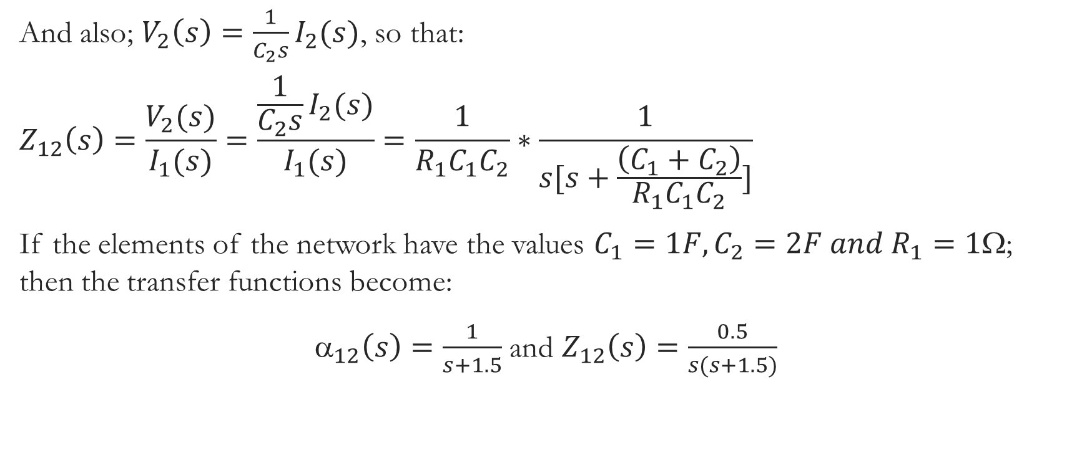
Cont …
And also; $V_{2}\left(s\right)=\frac{1}{C_{2}s}I_{2}(s)$, so that:
$$Z_{12}\left(s\right)=\frac{V_{2}(s)}{I_{1}(s)}=\frac{\frac{1}{C_{2}s}I_{2}(s)}{I_{1}(s)}=\frac{1}{R_{1}C_{1}C_{2}}∗\frac{1}{s[s+\frac{\left(C_{1}+C_{2}\right)}{R_{1}C_{1}C_{2}}]}$$
If the elements of the network have the values $C_{1}=1F,C_{2}=2F and R_{1}=1$; then the transfer functions become:
$_{12}\left(s\right)=\frac{1}{s+1.5}$ and $Z_{12}\left(s\right)=\frac{0.5}{s(s+1.5)}$

Slide 16
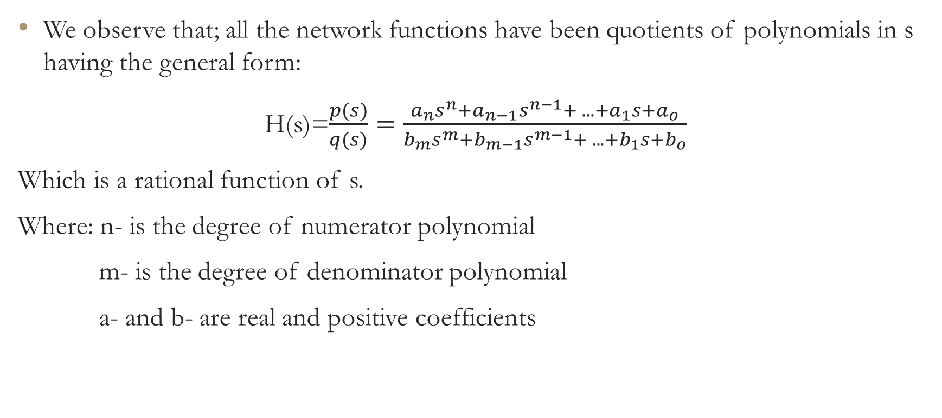
Cont …
We observe that; all the network functions have been quotients of polynomials in s having the general form:
H(s)=$\frac{p(s)}{q(s)}=\frac{a_{n}s^{n}+a_{n−1}s^{n−1}+ . . . +a_{1}s+a_{o}}{b_{m}s^{m}+b_{m−1}s^{m−1}+ . . . +b_{1}s+b_{o}}$
Which is a rational function of s.
Where: n- is the degree of numerator polynomial
m- is the degree of denominator polynomial
a- and b- are real and positive coefficients

Slide 17
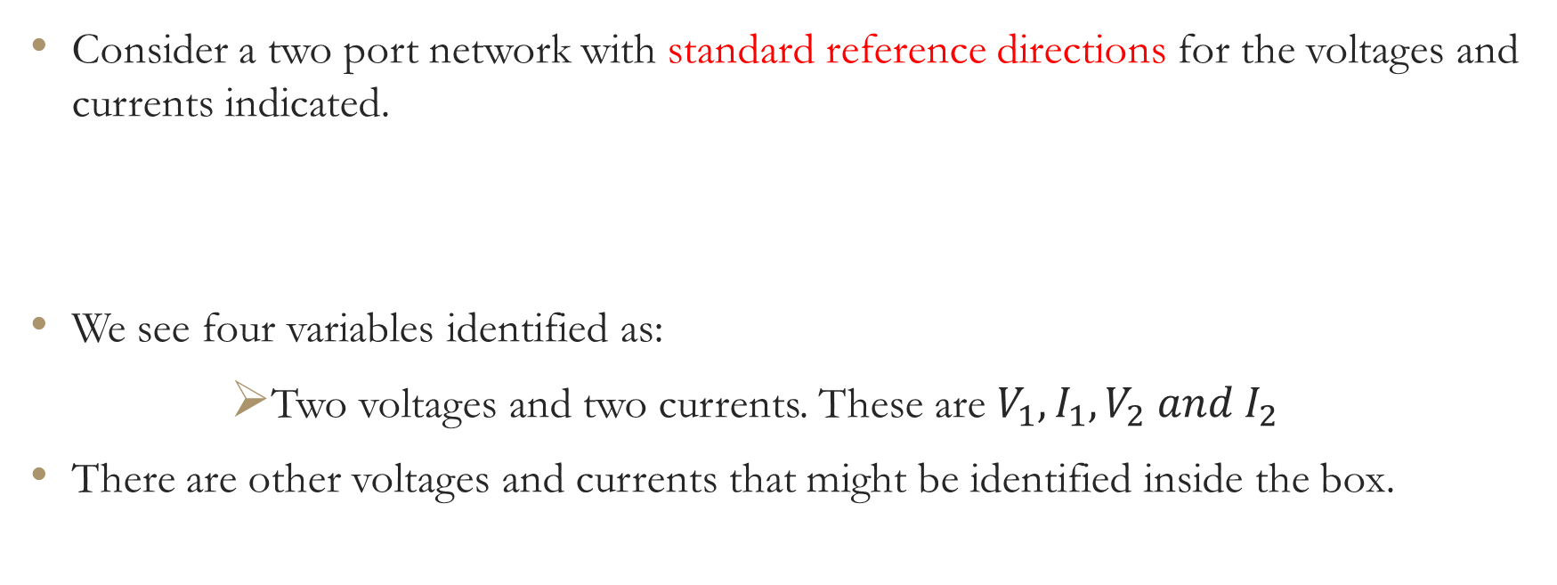
RELATION BETWEEN TWO PORT PARAMETERS
Consider a two port network with standard reference directions for the voltages and currents indicated.
We see four variables identified as:
      Two voltages and two currents. These are $V_{1},I_{1},V_{2} and I_{2}$
There are other voltages and currents that might be identified inside the box.

Slide 18
Cont …
Now; only two of the four variables are independent and the specification of any two of them determines the remaining two.
The dependence of two of the four variables on the other two is described in a number of ways, depending on which of the variables are chosen to be the independent variables.
In this chapter we study six combinations that are given in the table below.
The name of the parameters are chosen to indicate:
    Dimensions (impedance, admittance)
    Lack of consistent dimensions (hybrid)
    The principal application of the parameter (Transmission)

Slide 19
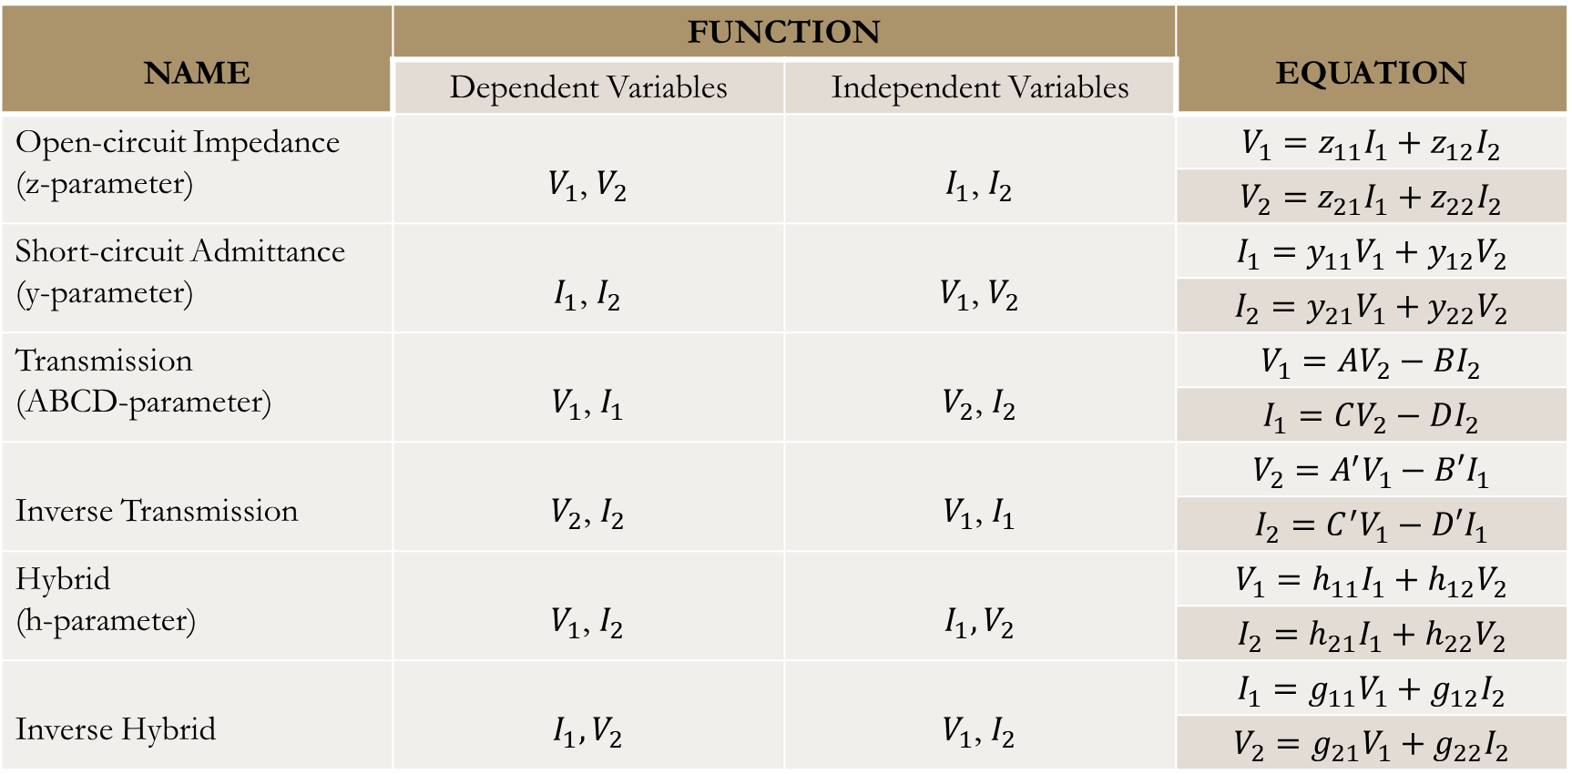
.0
NAME | FUNCTION |  | EQUATION
 | Dependent Variables | Independent Variables
Open-circuit Impedance (z-parameter) | $V_{1}$, $V_{2}$ | $I_{1}$, $I_{2}$ | $$V_{1}=z_{11}I_{1}+z_{12}I_{2}$$
 |  |  | $$V_{2}=z_{21}I_{1}+z_{22}I_{2}$$
Short-circuit Admittance (y-parameter) | $I_{1}$, $I_{2}$ | $V_{1}$, $V_{2}$ | $$I_{1}=y_{11}V_{1}+y_{12}V_{2}$$
 |  |  | $$I_{2}=y_{21}V_{1}+y_{22}V_{2}$$
Transmission (ABCD-parameter) | $V_{1}$, $I_{1}$ | $V_{2}$, $I_{2}$ | $$V_{1}=AV_{2}−BI_{2}$$
 |  |  | $$I_{1}=CV_{2}−DI_{2}$$
Inverse Transmission | $V_{2}$, $I_{2}$ | $V_{1}$, $I_{1}$ | $$V_{2}=A^{′}V_{1}−B′I_{1}$$
 |  |  | $$I_{2}=C^{′}V_{1}−D′I_{1}$$
Hybrid (h-parameter) | $V_{1}$, $I_{2}$ | $I_{1},V_{2}$ | $$V_{1}=h_{11}I_{1}+h_{12}V_{2}$$
 |  |  | $$I_{2}=h_{21}I_{1}+h_{22}V_{2}$$
Inverse Hybrid | $I_{1},V_{2}$ | $V_{1}$, $I_{2}$ | $$I_{1}=g_{11}V_{1}+g_{12}I_{2}$$
 |  |  | $$V_{2}=g_{21}V_{1}+g_{22}I_{2}$$

Slide 20
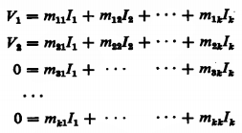
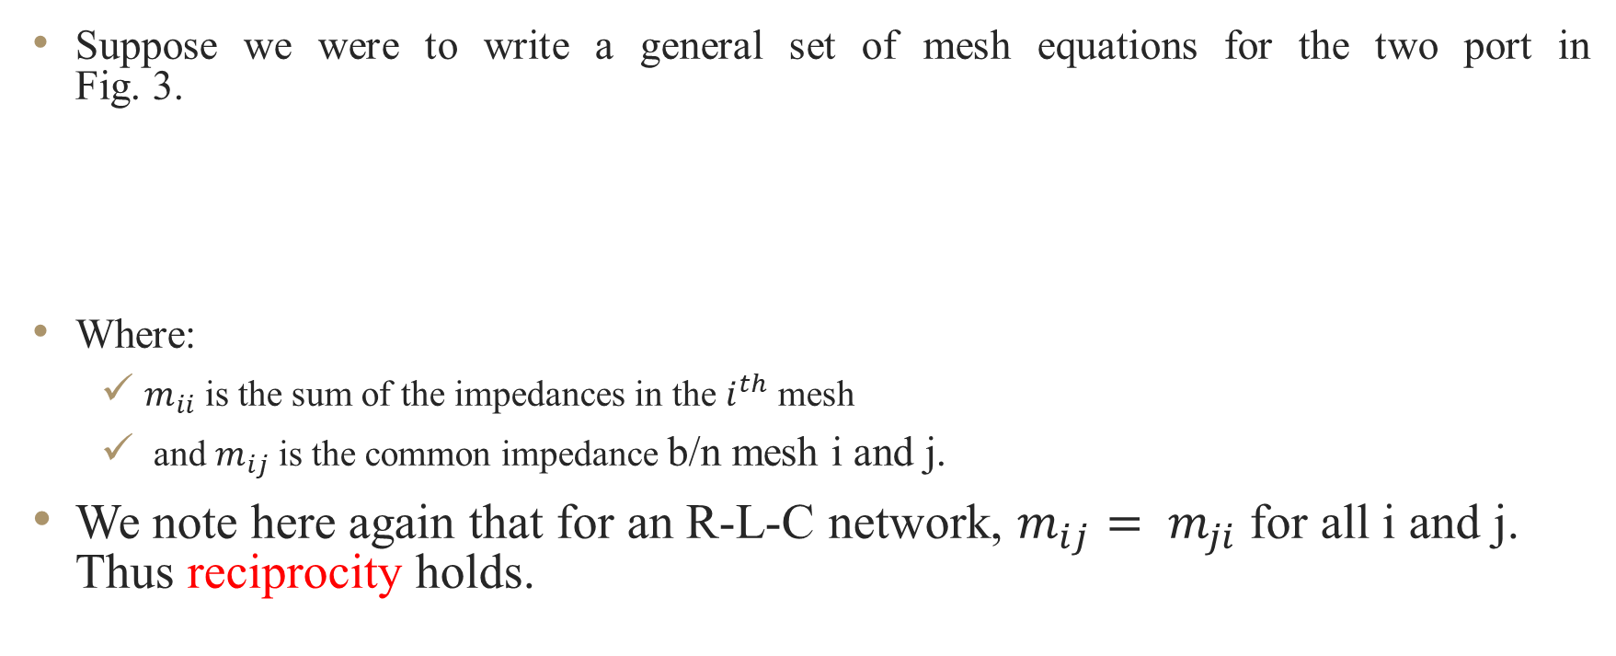
The y-parameters
(Short-Circuit Admittance Parameters)
Suppose we were to write a general set of mesh equations for the two port in
Fig. 3.
Where:
  $m_{ii}$ is the sum of the impedances in the $i^{th}$ mesh
  and $m_{ij}$ is the common impedance b/n mesh i and j.
We note here again that for an R-L-C network, $m_{ij}= m_{ji}$ for all i and j. Thus reciprocity holds.

Slide 21


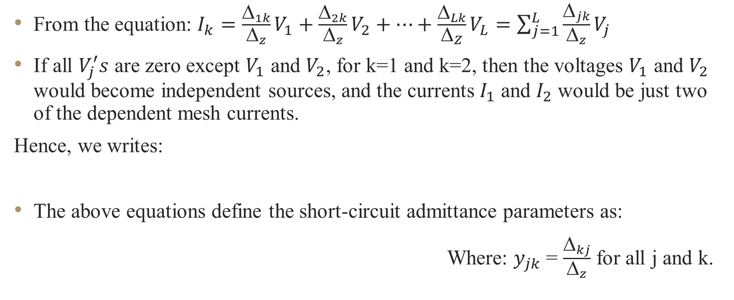
Cont …
From the equation: $I_{k}=\frac{_{1k}}{_{z}}V_{1}+\frac{_{2k}}{_{z}}V_{2}+…+\frac{_{Lk}}{_{Z}}V_{L}=\sum_{j=1}^{L}{\frac{_{jk}}{_{z}}V_{j}}$
If all $V_{j}^{′}s$ are zero except $V_{1}$ and $V_{2}$, for k=1 and k=2, then the voltages $V_{1}$ and $V_{2}$ would become independent sources, and the currents $I_{1}$ and $I_{2}$ would be just two of the dependent mesh currents.
Hence, we writes:
The above equations define the short-circuit admittance parameters as:
Where: $y_{jk}$ = $\frac{Δ_{kj}}{Δ_{z}}$ for all j and k.

Slide 22
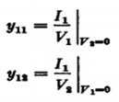
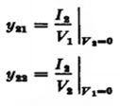
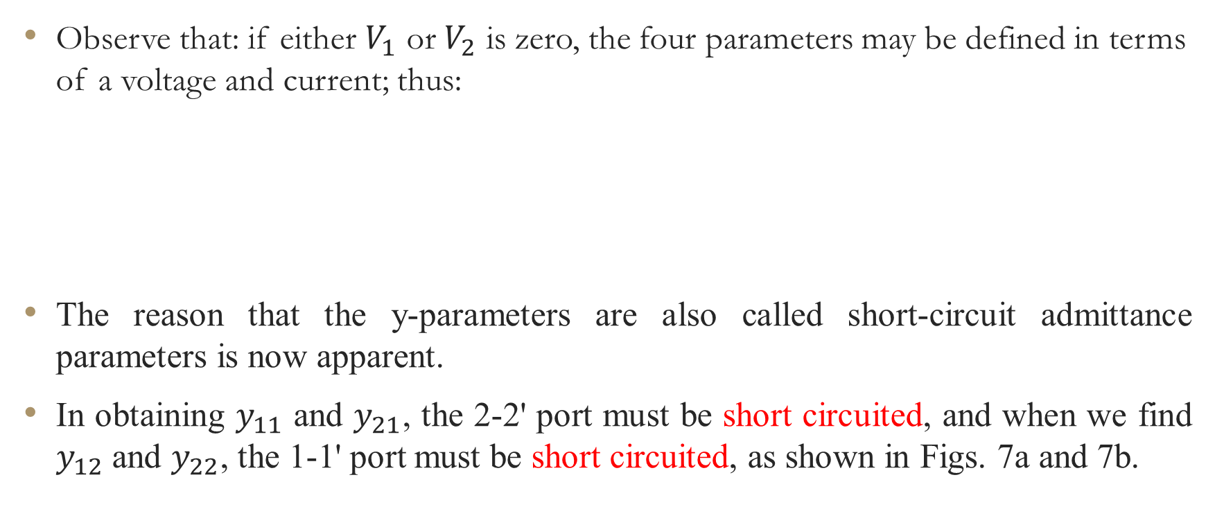
Cont …
Observe that: if either $V_{1}$ or $V_{2}$ is zero, the four parameters may be defined in terms of a voltage and current; thus:
The reason that the y-parameters are also called short-circuit admittance parameters is now apparent.
In obtaining $y_{11}$ and $y_{21}$, the 2-2' port must be short circuited, and when we find $y_{12}$ and $y_{22}$, the 1-1' port must be short circuited, as shown in Figs. 7a and 7b.

Slide 23
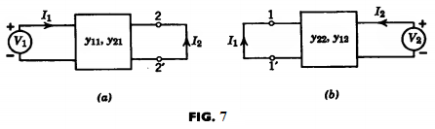
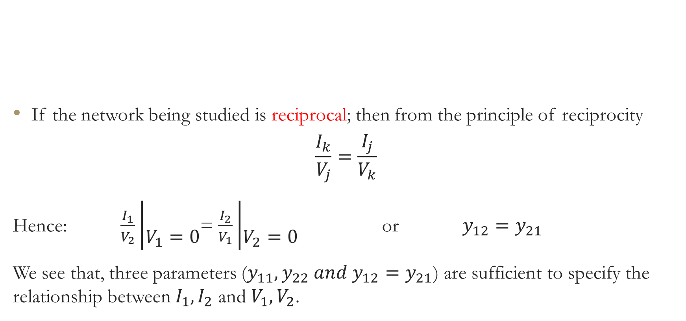
Cont …
If the network being studied is reciprocal; then from the principle of reciprocity
$$\frac{I_{k}}{V_{j}}=\frac{I_{j}}{V_{k}}$$
Hence: $\frac{I_{1}}{V_{2}}\left|\begin{aligned} \\ V_{1}=0\end{aligned}\right.$= $\frac{I_{2}}{V_{1}}\left|\begin{aligned} \\ V_{2}=0\end{aligned}\right.$ or $y_{12}=y_{21}$
We see that, three parameters ($y_{11}, y_{22} and y_{12}=y_{21}$) are sufficient to specify the relationship between $I_{1},I_{2}$ and $V_{1},V_{2}$.

Slide 24
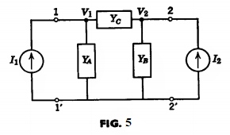


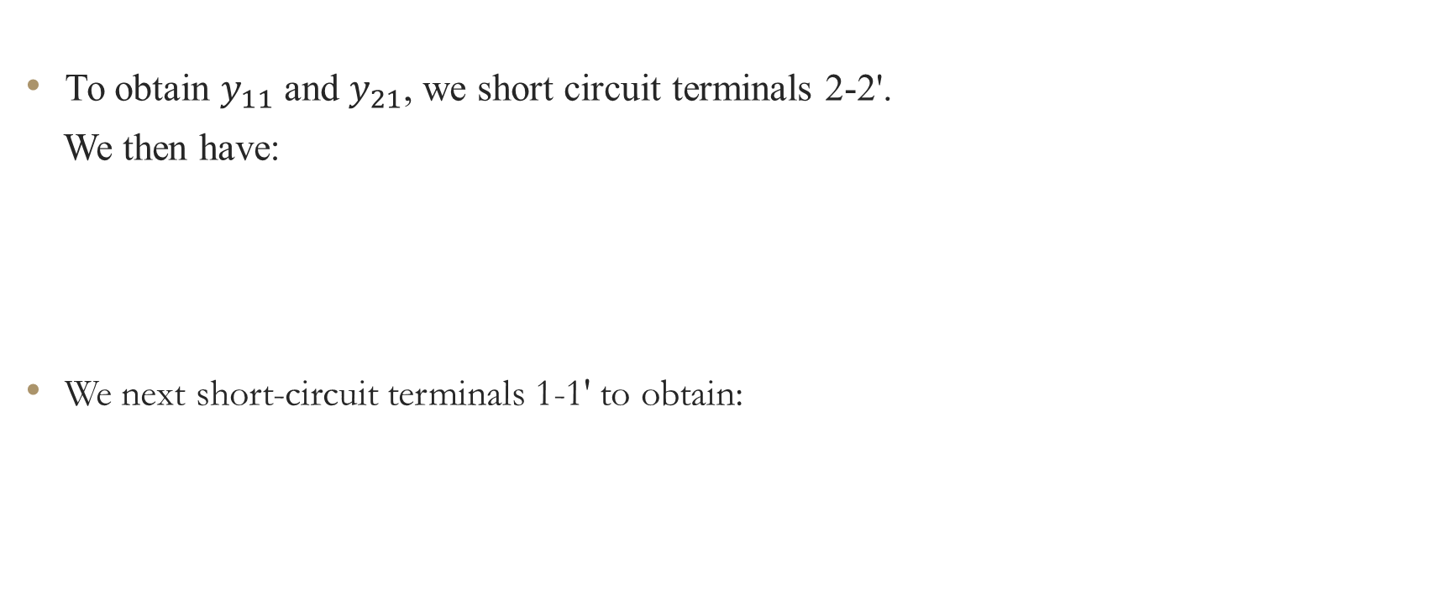
Example: let us obtain the y-parameters of the Pi circuit in Fig. 5 below.
To obtain $y_{11}$ and $y_{21}$, we short circuit terminals 2-2'.
We then have:
We next short-circuit terminals 1-1' to obtain:

Slide 25
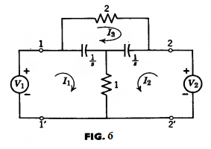
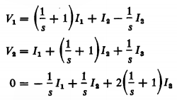
Cont …
Let us find the y parameters for the bridged-T circuit given in Fig. 6.
The mesh equations for the circuit are:

Slide 26
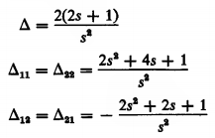
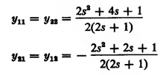
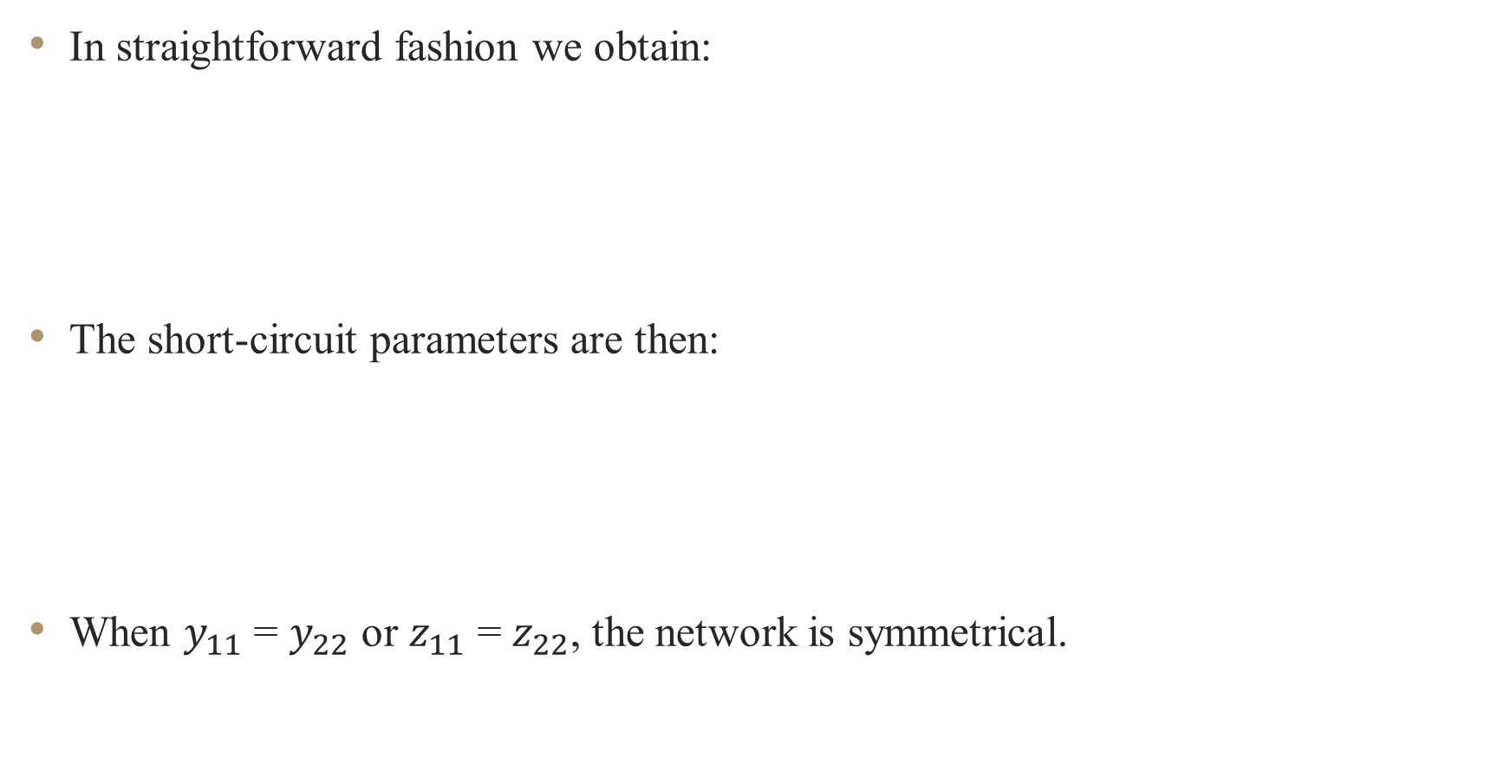
Cont …
In straightforward fashion we obtain:
The short-circuit parameters are then:
When $y_{11}$ = $y_{22}$ or $z_{11}$ = $z_{22}$, the network is symmetrical.

Slide 27
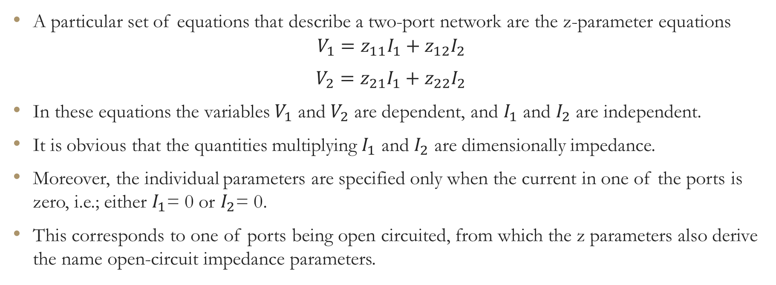
z-parameters
(Open-Circuit Impedance Parameters)
A particular set of equations that describe a two-port network are the z-parameter equations
$V_{1}=z_{11}I_{1}+z_{12}I_{2}$
$V_{2}=z_{21}I_{1}+z_{22}I_{2}$
In these equations the variables $V_{1}$ and $V_{2}$ are dependent, and $I_{1}$ and $I_{2}$ are independent.
It is obvious that the quantities multiplying $I_{1}$ and $I_{2}$ are dimensionally impedance.
Moreover, the individual parameters are specified only when the current in one of the ports is zero, i.e.; either $I_{1}$= 0 or $I_{2}$= 0.
This corresponds to one of ports being open circuited, from which the z parameters also derive the name open-circuit impedance parameters.

Slide 28
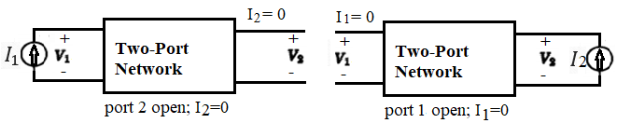
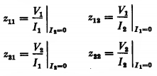
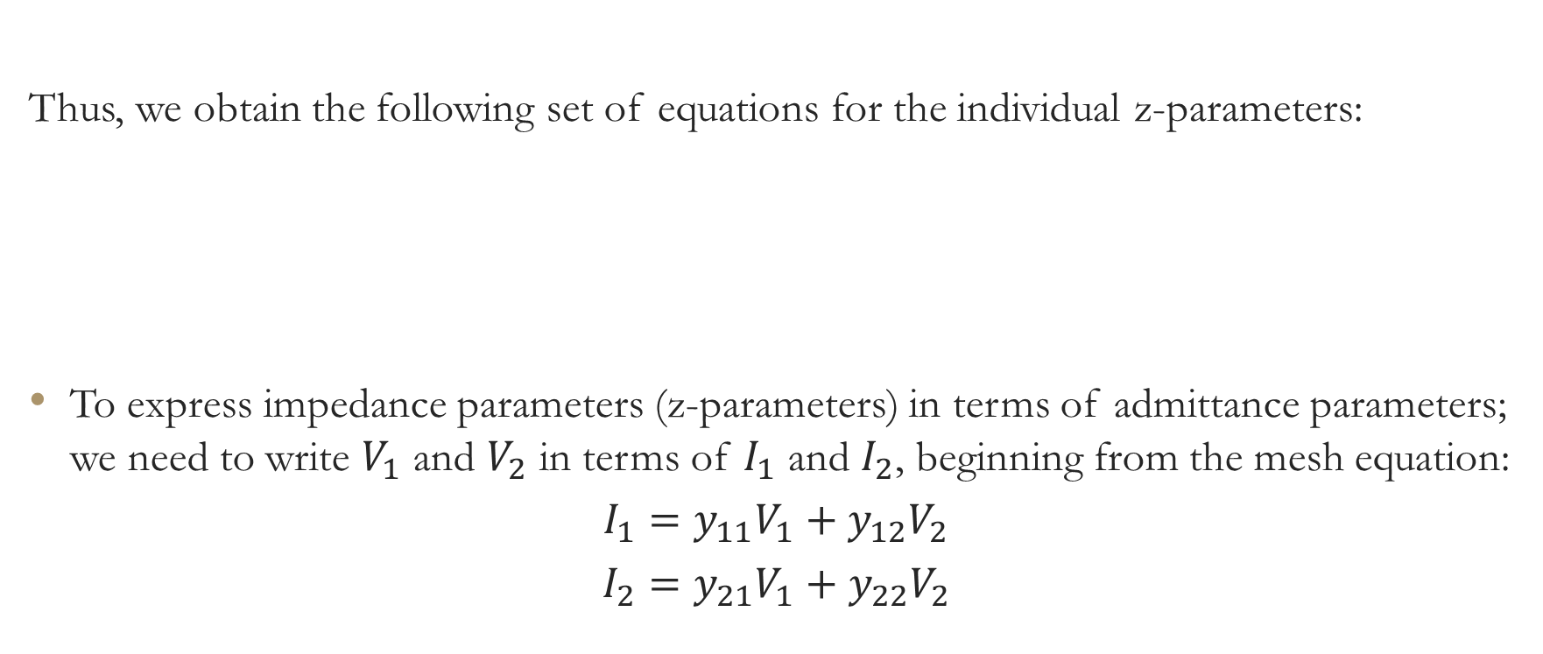
Cont …
Thus, we obtain the following set of equations for the individual z-parameters:
To express impedance parameters (z-parameters) in terms of admittance parameters; we need to write $V_{1}$ and $V_{2}$ in terms of $I_{1}$ and $I_{2}$, beginning from the mesh equation:
$$I_{1}=y_{11}V_{1}+y_{12}V_{2}$$
$$I_{2}=y_{21}V_{1}+y_{22}V_{2}$$

Slide 29
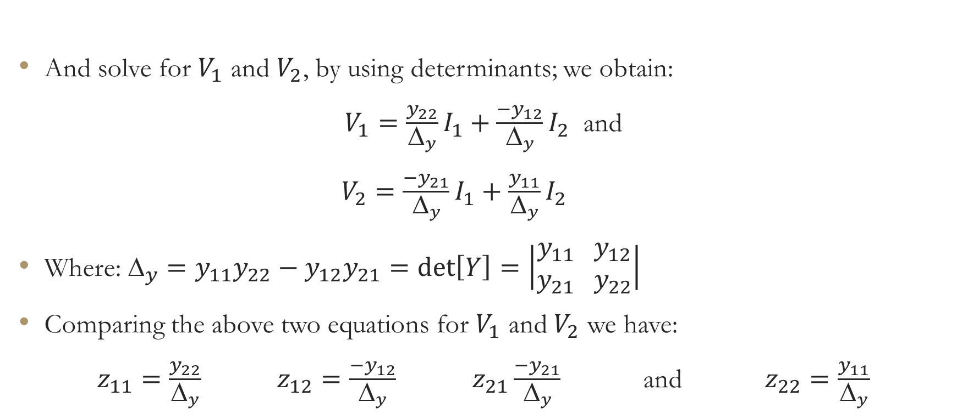
Cont …
And solve for $V_{1}$ and $V_{2}$, by using determinants; we obtain:
$V_{1}=\frac{y_{22}}{Δ_{y}}I_{1}+\frac{{−y}_{12}}{Δ_{y}}I_{2}$ and
$V_{2}=\frac{{−y}_{21}}{Δ_{y}}I_{1}+\frac{y_{11}}{Δ_{y}}I_{2}$
Where: $_{y}=y_{11}y_{22}−y_{12}y_{21}=\det\left[Y\right]=\left|\begin{aligned}y_{11} y_{12} \\ y_{21} y_{22}\end{aligned}\right|$
Comparing the above two equations for $V_{1}$ and $V_{2}$ we have:
$z_{11}=\frac{y_{22}}{Δ_{y}}$ $z_{12}=\frac{{−y}_{12}}{Δ_{y}}$ $z_{21}\frac{{−y}_{21}}{Δ_{y}}$ and $z_{22}=\frac{y_{11}}{Δ_{y}}$

Slide 30
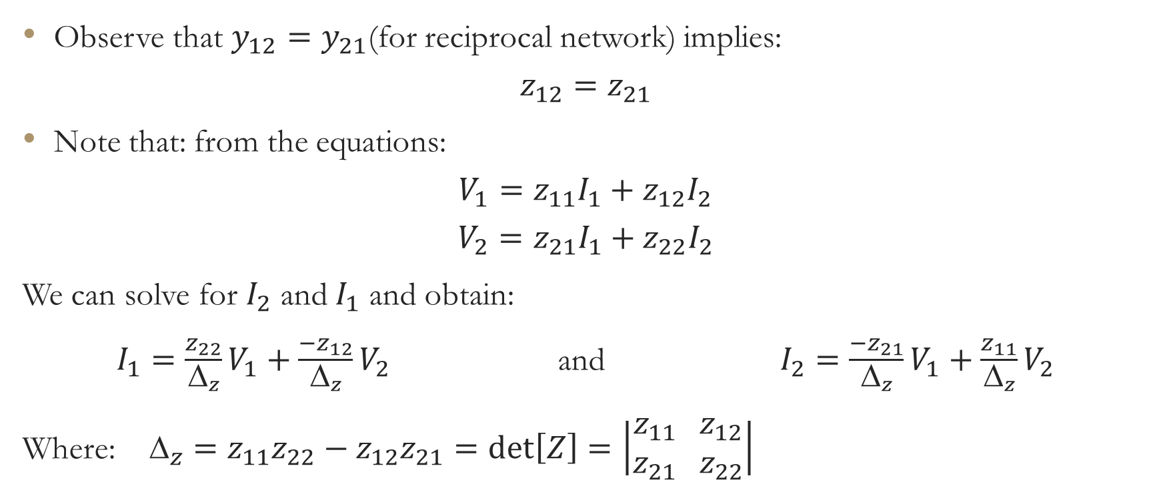
Cont …
Observe that $y_{12}=y_{21}$(for reciprocal network) implies:
$$z_{12}=z_{21}$$
Note that: from the equations:
$$V_{1}=z_{11}I_{1}+z_{12}I_{2}$$
$$V_{2}=z_{21}I_{1}+z_{22}I_{2}$$
We can solve for $I_{2}$ and $I_{1}$ and obtain:
$I_{1}=\frac{z_{22}}{Δ_{z}}V_{1}+\frac{{−z}_{12}}{Δ_{z}}V_{2}$ and $I_{2}=\frac{{−z}_{21}}{Δ_{z}}V_{1}+\frac{z_{11}}{Δ_{z}}V_{2}$
Where: $_{z}=z_{11}z_{22}−z_{12}z_{21}=\det\left[Z\right]=\left|\begin{aligned}z_{11} z_{12} \\ z_{21} z_{22}\end{aligned}\right|$

Slide 31
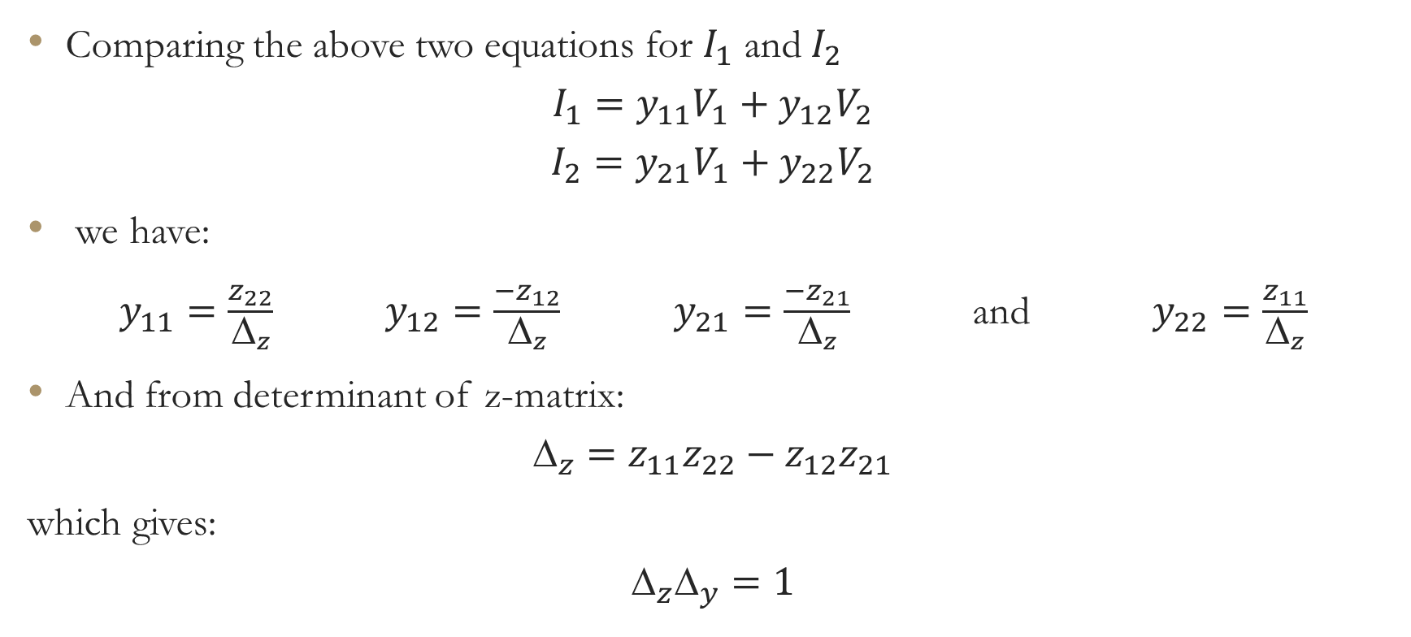
Cont …
Comparing the above two equations for $I_{1}$ and $I_{2}$
$$I_{1}=y_{11}V_{1}+y_{12}V_{2}$$
$$I_{2}=y_{21}V_{1}+y_{22}V_{2}$$
we have:
$y_{11}=\frac{z_{22}}{Δ_{z}}$ $y_{12}=\frac{{−z}_{12}}{Δ_{z}}$ $y_{21}=\frac{{−z}_{21}}{Δ_{z}}$ and $y_{22}=\frac{z_{11}}{Δ_{z}}$
And from determinant of z-matrix:
$$_{z}=z_{11}z_{22}−z_{12}z_{21}$$
which gives:
$$_{z}_{y}=1$$

Slide 32
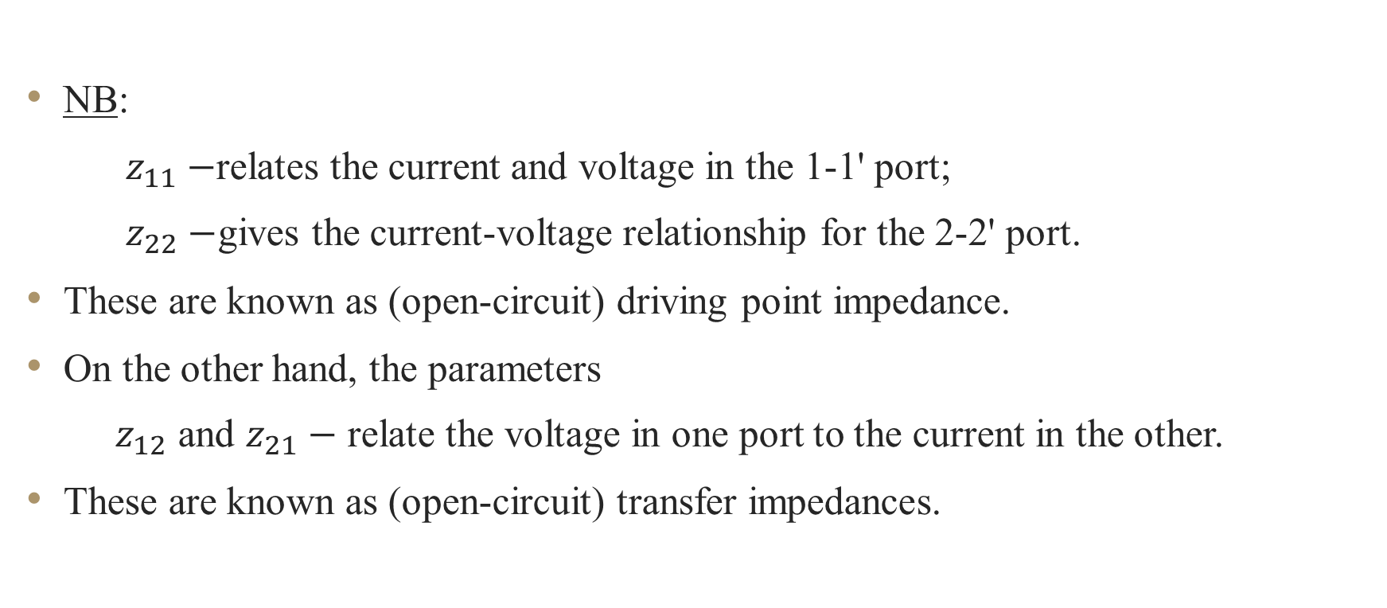
Cont …
NB:
$z_{11}−$relates the current and voltage in the 1-1' port;
$z_{22}−$gives the current-voltage relationship for the 2-2' port.
These are known as (open-circuit) driving point impedance.
On the other hand, the parameters
$z_{12}$ and $z_{21}−$ relate the voltage in one port to the current in the other.
These are known as (open-circuit) transfer impedances.

Slide 33
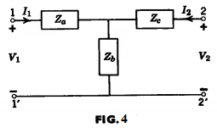
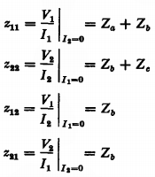
Example: Find the open-circuit parameters for the T circuit in Fig. 4.
We obtain the z parameters by inspection as:

Slide 34


As an example, let us find the z parameters of the Pi circuit in Fig. 5.
The node equations are:
The determinant for this set of equations is:

Slide 35
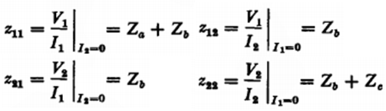
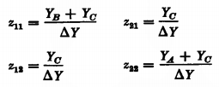

Cont …
$z_{11}=\frac{Y_{B}+Y_{C}}{Δ_{Y}}$ $z_{21}=\frac{Y_{C}}{Δ_{Y}}$ $z_{12}=\frac{Y_{C}}{Δ_{Y}}$ $z_{22}=\frac{Y_{A}+Y_{C}}{Δ_{Y}}$
Now let us perform a delta-wye transformation for the circuits in Figs. 4 and 5.

Slide 36


Cont …
In other words, let us find relationships between the immittances of the two circuits so that they both have the same z parameters.
We readily obtain:
We then find:

Slide 37


Cont …
The set of equations for open-circuit impedance parameter analysis may be consolidated to alternative interpretations of the set of equations in terms of equivalent networks.
The two generator equivalent of the general two port network in terms of the open circuit impedance functions.
Applying KVL:
$V_{1}=z_{11}I_{1}+z_{12}I_{2}$
$V_{2}=z_{21}I_{1}+z_{22}I_{2}$

Slide 38


Cont …
We can obtain one-generator equivalent circuit, the $z_{12}I_{1}$is added to and subtracted from the second equation.
$$V_{1}=z_{11}I_{1}+z_{12}I_{2}$$
$V_{2}=z_{12}I_{1}+z_{22}I_{2}+(z_{21}−z_{12})I_{1}$
For reciprocity; $z_{12}=z_{21}$, and the last term in $V_{2}$vanishes and give a simple T-network.

Slide 39
Cont …
A dual analysis to the one just presented for the short circuit admittance equations leads to one generator and two generator equivalent two-port networks shown below.

Slide 40


The ABCD parameters
Let us take the dependent variables as the voltage and current at the port 1, and define the following equation.
This matrix equation defines the A, B, C, D parameters, whose matrix is known as the transmission matrix because it relates the voltage and current at the input port to their corresponding quantities at the output.
The reason the current $I_{2}$ carries a negative sign is that most transmission engineers like to regard their output current as coming out of the output port instead of going into the port, as per standard usage.

Slide 41

Cont …
In explicit form, the ABCD parameters can be expressed as:
From these relations we see that:
  A represents an open-circuit voltage transfer function;
  B represents a short-circuit transfer impedance;
  C represents an open-circuit transfer admittance; and
  D represents a short circuit current ratio.
Note that all four parameters are transfer functions so that the term transmission matrix is a very appropriate one.

Slide 42


Cont …
Let us describe the short-circuit transfer functions B and D in terms of y parameters, and the open-circuit transfer functions A and C in terms of z parameters.
Using straightforward algebraic operations, we obtain:
For the ABCD parameters, the reciprocity condition is expressed by the equation:

Slide 43




Cont …
Example: Let us find the ABCD parameter for the ideal transformer in Fig. 9, whose defining equations are:
$V_{1}=nV_{2}$
$I_{1}= \frac{1}{n}\left(−I_{2}\right)$
Expressing the above equation in matrix form, we have:
So that the transmission matrix of the ideal transformer is:

Slide 44


Cont …
Example: Consider the ABCD parameters of the Pi circuit in Fig. 5.
If we check for reciprocity from these equation, we see that:

Slide 45



The h-parameters
A set of parameters that are extremely useful in describing transistor circuits are the h-parameters given by the equations:
The individual parameters are defined by the relationships:
We see that $h_{11}$ and $h_{21}$ are short-circuit type parameters, and $h_{12}$ and $h_{22}$ are open-circuit type parameters.

Slide 46

Cont …
The parameter $h_{11}$ can be interpreted as the input impedance at port 1 with port 2 short circuited.
It is easily seen that $h_{11}$ is merely the reciprocal of $y_{11}$.
$h_{11}= \frac{1}{y_{11}}$
The parameter $h_{22}$ is an open-circuit admittance parameter and is related to $z_{22}$ by:
$h_{22}= \frac{1}{z_{22}}$
Both the remaining h-parameters are transfer functions; $h_{21}$ is a short circuit current ratio, and $h_{21}$ is an open-circuit voltage ratio.

Slide 47



Cont …
For the Pi circuit in Fig. 5, the h-parameters are:
Observe that for the Pi circuit, $h_{21}$= $h_{12}$.
This is the reciprocity condition for the h-parameters and can be derived from their relationships to either the z or y parameters.

Slide 48


Negative Impedance Converter (NIC)
Let us consider the h-parameters of an ideal device called the negative impedance converter (NIC), which converts a positive load impedance into a negative impedance at its input port.
Consider the NIC with a load impedance $Z_{L}$ shown in Fig. 8 below.
Its input impedance is:
$Z_{in}=− Z_{L}$

Slide 49

Cont …
which can be rewritten as:
$$\frac{V_{1}}{I_{1}}= \frac{V_{2}}{I_{2}}$$
The following voltage-current relationship hold for the NIC.
$$V_{1}=kV_{2}$$
$$I_{1}=kI_{2}$$
If we interpret the above equation using h-parameters, we arrive at the following
conditions.
$$h_{11}= h_{22}=0$$
$$h_{12}= \frac{1}{h_{21}}=k$$
We see that since $h_{12}$ ≠ - $h_{21}$, the NIC is nonreciprocal.

Slide 50

Cont …
In matrix notation, the h matrix of the NIC is:
The NIC is a convenient device in the modeling of active circuits.
It is not, however, a device that exists only in the imagination. Practical realizations of NIC's have been achieved using transistors.

Slide 51

RELATIONSHIPS BETWEEN TWO-PORT PARAMETERS
The relationships between two-port parameters are quite easily obtained because of the simple algebraic nature of the two-port equations.
For example, we have seen that $h_{11}$= $1/{y_{11}}$ and $h_{22}$ = $1/{z_{22}}$.
To derive $h_{12}$ in terms of open-circuit parameters, consider the z parameter equations when port 1 is open circuited: $I_{1}$ = 0.
$$V_{1}= z_{12}I_{2}$$
$$V_{2}= z_{22}I_{2}$$

Slide 52



Cont …
Therefore we have:
Similarly, since $h_{21}$ is defined as a short-circuit type parameter, we can derive $h_{21}$ in terms of y-parameters as:
We can express all the h-parameters as functions of the z-parameters or y-parameters alone.
An easy way to accomplish this task is by finding out what the relationships are between the z and y parameters themselves.

Slide 53



Cont …
Certainly, by their very nature, the z and y parameters are not simply reciprocals of each other (as the novice might guess), since one set of parameters is defined for open-circuit conditions and the other for short circuit.
The z- and y- relationships can be obtained very easily by using matrix notation.
If we define the z matrix as:
and the y matrix as:
In simplified notation we can write the two sets of equations as:
$\left[V\right]$ = $\left[Z\right]\left[I\right]$ ………. (a)
$\left[I\right]$ = $\left[Y\right]\left[V\right]$ ………. (b)

Slide 54

Cont …
Replacing [I] in equation (a) by the expression [Y][V] in equation (b), we obtain:
$$\left[V\right]=\left[Z\right]\left[Y\right]\left[V\right]$$
So that the product [Z][Y] must yield the unit matrix [U].
The matrices [Y] and [Z] must therefore be inverses of each other, that is,
${\left[Z\right]}^{−1}= \left[Y\right]$ and ${\left[Y\right]}^{−1}= \left[Z\right]$
From the relationship, we can find the relations between the individual z- and y- parameters.
$y_{11}$ = $\frac{z_{22}}{Δ_{z}}$ $y_{22}$ = $\frac{z_{11}}{Δ_{z}}$
$y_{12}$ = $−\frac{z_{12}}{Δ_{z}}$ $y_{21}$ = $−\frac{z_{21}}{Δ_{z}}$ where $_{z}$ = $z_{11}z_{22} − z_{12}z_{21}$

Slide 55

Cont …
And
$z_{11}$ = $\frac{y_{22}}{Δ_{y}}$ $z_{22}$ = $\frac{y_{11}}{Δ_{y}}$
$z_{12}$ = $−\frac{y_{12}}{Δ_{y}}$ $z_{21}$ = $−\frac{y_{21}}{Δ_{y}}$ where $_{y}$ = $y_{11}y_{22} − y_{12}y_{21}$
Using these identities we can derive the h or ABCD parameters in terms of either the z- or y- parameters.
Table 1 provides a conversion table to facilitate the process.
Note that in the table:
$_{T}=AD −BC$

Slide 56

.

Slide 57

.

Slide 58

TRANSFER FUNCTIONS USING TWO-PORT PARAMETERS
In this section we will examine how to determine driving-point and transfer functions of a two-port by use of two-port parameters.
These functions fall into two broad categories.
  The first applies to two-ports without load and source impedances. These transfer functions can be described by means of z- or y- parameters alone.
  For example, let us derive the expressions for the open-circuit voltage ratio ${V_{2}}/{V_{1}}$ by using z-parameters first and y-parameters next.

Slide 59






Cont …
  Consider the z-parameter equations for the two-port when port 2 is open circuited.
If we take the ratio of $V_{2}$ to $V_{1}$, we obtain:
By letting $I_{2}$ of the second y-parameter equation go to zero, we derive the open-circuit voltage ratio as:
In similar manner we can derive the short-circuit current ratio of a two-port as:
and

Slide 60


Cont …
The open- and short-circuit transfer functions are not those we usually deal with in practice, since there are frequently source and load impedances to account for.
  The second category of two-port transfer functions are those including source or load impedances.
  These transfer functions are functions of the two-port parameters z-, h-, or y- and the source and/or load impedance.
For example, let us derive the transfer admittance ${I_{2}}/{V_{1}}$ of a two-port network that is terminated in a resistor of R ohms, as given in Fig. 1 1.

Slide 61



Cont …
For this two-port network, the following equations apply.
By eliminating the variable $V_{2}$, we obtain:
Note that $Y_{21}$ and $y_{21}$ are not the same.
  $Y_{21}$ is the transfer admittance of the two-port network terminated in a resistor R, and
  $y_{21}$ is the transfer admittance when port 2 is short circuited.
We must be careful to make this distinction in other cases of a similar nature.

Slide 62



Cont …
In order to solve for transfer functions of two-ports terminated at either port by an impedance $Z_{L}$, it is convenient to use the equivalent circuit of the two-port network given in terms of its z-parameters (Fig. 12) or y-parameters (Fig. 13).

Slide 63



Cont …
The equivalent voltage sources $z_{12}I_{2}$ and $z_{21}I_{1}$ in Fig. 12 are called controlled sources because they depend upon a current or voltage somewhere in the network.
Similarly, the current sources $y_{12}V_{2}$ and $y_{21}V_{1}$ are controlled sources.
For the circuit in Fig. 12, let us find the transfer impedance $z_{21}= {V_{2}}/{I_{1}}$ with port 2 terminated in a load impedance $Z_{L}$.
If we write the mesh equation for the $I_{2}$ mesh, we have:
Since $V_{2}=−I_{2}Z_{L}$, we readily obtain:

Slide 64



Cont …
In similar fashion, we obtain the voltage-ratio transfer function for the circuit represented in Fig. 13 as:
Next, suppose we are required to find the transfer function ${V_{2}}/{V_{G}}$ for the two-port network terminated at both ends, as shown in Fig. 14.

Slide 65




Cont …
We first write the two mesh equations:
Next, we solve for $I_{2}$ to give:
From the equation $V_{2}=−R_{2}I_{2}$, we may now arrive at the following solution.
Note that the equivalent circuits of the two-ports in Figs. 12 and 13 are not unique.

Slide 66


Cont …
Two other examples are given in Figs. 15 and 16.
Observe that the controlled sources are nonzero in these equivalent circuits only if the circuit is nonreciprocal.

Slide 67



Cont …
Finally, let us consider the hybrid equivalent circuit shown in Fig. 17.
Observe the voltage-controlled source $h_{12}V_{2}$ at port 1 and the current controlled source $h_{21}I_{1}$ at port 2.
Let us find the input impedance $Z_{in}$. The pertinent equations are:

Slide 68




Cont …
Solving the second equation for $V_{2}$, we find:
Substituting $V_{2}$ into the first equation, we have:
So that:
We can easily check that the last equation is dimensionally correct since $h_{11}$ has the dimensions of impedance, $h_{22}$ is an admittance, and $h_{12}$ and $h_{21}$ are dimensionless since they represent voltage and current ratios, respectively.

Slide 69
INTERCONNECTION OF TWO-PORTS
In this section we will consider various interconnections of two-ports.
We will see that:
  when a pair of two-ports are cascaded, the overall transmission matrix is equal to the product of the individual transmission matrices of the two-ports.
  when two two-ports are connected in series, their z matrices add ;
  when two two-ports are connected in parallel, their y matrices add.

Slide 70


Cascade (Tandem) Connection
Let us consider the case in which we connect a pair of two port networks $N_{a}$ and $N_{b}$ in cascade or in tandem, as shown in Fig. 18.
We see that: $\left[\begin{aligned}V_{2a} \\ −I_{2a}\end{aligned}\right]$ = $\left[\begin{aligned}V_{1b} \\ I_{1b}\end{aligned}\right]$
The transmission matrix equation for $N_{a}$ is: $\left[\begin{aligned}V_{1} \\ I_{1}\end{aligned}\right]= \left[\begin{aligned}A_{a} B_{a} \\ C_{a} D_{a}\end{aligned}\right]\left[\begin{aligned}V_{2a} \\ {−I}_{2a}\end{aligned}\right]$

Slide 71

Cont …
Correspondingly, for $N_{b}$ we have: $\left[\begin{aligned}V_{2a} \\ −I_{2a}\end{aligned}\right]= \left[\begin{aligned}V_{1b} \\ I_{1b}\end{aligned}\right]= \left[\begin{aligned}A_{b} B_{b} \\ C_{b} D_{b}\end{aligned}\right]\left[\begin{aligned}V_{2} \\ {−I}_{2}\end{aligned}\right]$
Substituting the second matrix into the first, we obtain:
$\left[\begin{aligned}V_{1} \\ I_{1}\end{aligned}\right]= \left[\begin{aligned}A_{a} B_{a} \\ C_{a} D_{a}\end{aligned}\right].\left[\begin{aligned}A_{b} B_{b} \\ C_{b} D_{b}\end{aligned}\right]\left[\begin{aligned}V_{2} \\ {−I}_{2}\end{aligned}\right]$
We see that the transmission matrix of the overall two-port network is simply the product of the transmission matrices of the individual two ports.

Slide 72


Parallel Connection
Consider the situation in which a pair of two-ports $N_{a}$ and $N_{b}$ are connected in parallel, as shown in Fig. 19.
Let us find the y-parameters for the overall two-port network. The matrix equations for the individual two-ports are:$\left[\begin{aligned}I_{1a} \\ I_{2a}\end{aligned}\right]= \left[\begin{aligned}y_{11a} y_{12a} \\ y_{21a} y_{22a}\end{aligned}\right]\left[\begin{aligned}V_{1a} \\ V_{2a}\end{aligned}\right]$
and $\left[\begin{aligned}I_{1b} \\ I_{2b}\end{aligned}\right]= \left[\begin{aligned}y_{11b} y_{12b} \\ y_{21b} y_{22b}\end{aligned}\right]\left[\begin{aligned}V_{1b} \\ V_{2b}\end{aligned}\right]$

Slide 73

Cont …
From Fig. 19, we see that the following equations must hold.
$V_{1}= V_{1a}= V_{1b}$ $V_{2}= V_{2a}= V_{2b}$
$I_{1}= I_{1a}+ I_{1b}$ $I_{2}= I_{2a}+ I_{2b}$
In connecting two-ports in series or in parallel, we must be careful that the individual character of a two-port network is not altered when connected in series or parallel with another two-port.
For example, when we connect the two-ports in Fig. 20 in parallel, the impedances $Z_{7}$ and $Z_{8}$ will be short circuited. Therefore, to insure that a two-port network does not interfere with the internal affairs of the other, ideal transformers are used to provide the necessary isolation.

Slide 74


Cont …
In matrix notation, the sum of the individual $\left[I_{i}\right]$ matrices of the two-ports in parallel must equal the $\left[I\right]$ matrix of the overall two-port network. Thus we have:
$$\left[\begin{aligned}I_{1} \\ I_{2}\end{aligned}\right]= \left[\begin{aligned}I_{1a} \\ I_{2a}\end{aligned}\right]+ \left[\begin{aligned}I_{1b} \\ I_{2b}\end{aligned}\right]= \left\{\left[\begin{aligned}y_{11a} y_{12a} \\ y_{21a} y_{22a}\end{aligned}\right]+\left[\begin{aligned}y_{11b} y_{12b} \\ y_{21b} y_{22b}\end{aligned}\right]\right\}\left[\begin{aligned}V_{1} \\ V_{2}\end{aligned}\right]$$
So that the y-parameters of the overall two-port network can be expressed in terms of the y-parameters of the individual two-ports as: $\left[\begin{aligned}y_{11} y_{12} \\ y_{21} y_{22}\end{aligned}\right]=\left[\begin{aligned}y_{11a}+y_{11b} y_{12a}+y_{12b} \\ y_{21a}+y_{21b} y_{22a}+y_{22b}\end{aligned}\right]$

Slide 75


Series Connection
If we connect two-ports in series, as shown in Fig. 21, we can express the z-parameters of the overall two-port network in terms of the z-parameters of the individual two-ports as:
$\left[\begin{aligned}z_{11} z_{12} \\ z_{21} z_{22}\end{aligned}\right]=\left[\begin{aligned}z_{11a}+z_{11b} z_{12a}+z_{12b} \\ z_{21a}+z_{21b} z_{22a}+z_{22b}\end{aligned}\right]$

Slide 76
Cont …
We may summarize by the following three points.
  When two-ports are connected in parallel, find the y-parameters first and from the y-parameters, derive the other two-port parameters.
  When two-ports are connected in series, it is usually easiest to find the z parameters.
  When two-ports are connected in tandem, the transmission matrix is generally easier to obtain.

Slide 77

Example:
Let us find the y-parameters of the bridged-T circuit in Fig. 6.
We see that the bridged-T circuit would be decomposed into a parallel connection of two-ports, as shown in Fig. 22.
Our task is to first find the y parameters of the two-ports $N_{a}$ and $N_{b}$.

Slide 78


Cont …
The y-parameters of $N_{b}$ are obtained by inspection
and are:
$$y_{12b}= y_{21b}=−\frac{1}{2}$$
$$y_{11b}= y_{22b}=\frac{1}{2}$$
$N_{a}$ is a T circuit so that the z-parameters can be obtained by inspection.
$z_{12a}= z_{21a}=$ 1
$$z_{11a}= z_{22a}=\frac{s+1}{s}$$

Slide 79

Cont …
We then find the y-parameters from the equations:
$y_{11a}= y_{22a}$ = $\frac{z_{22a}}{{Δz}_{a}}$ = $\frac{s(s+1)}{2s+1}$
$y_{12a}= y_{21a}$ = $\frac{z_{12a}}{{Δz}_{a}}$ = $−\frac{s^{2}}{2s+1}$
Since both $N_{a}$ and $N_{b}$ are symmetrical two-ports, we know that $y_{11}=y_{22}$ for the overall bridged-T circuit. The y-parameters for the bridged-T circuit are now obtained as: $y_{11}=y_{11a}+y_{11b}$ = $\frac{s(s+1)}{2s+1}$ +$\frac{1}{2}$ = $\frac{2s^{2}+4s+1}{2(2s+1)}$
$y_{12}$ =${ y}_{12a} + y_{12b}$ = $−\frac{s^{2}}{2s+1}$ $−\frac{1}{2}$ = $−\frac{2s^{2}+2s+1}{2(2s+1)}$

Slide 80

ANALYSIS OF LADDER NETWORKS
In this section we will consider a simple method of obtaining the network functions of a ladder network in a single operation.
This method depends only upon relationships that exist between the branch currents and node voltages of the ladder.
Consider the network shown in Fig. 23,

Slide 81

Cont …
Where all the series branches are given as impedances and all the parallel branches are given as admittances.
If $v$ denote node voltages and $i$ denote branch currents, then the following relationships apply.
$$v_{j+1}=i_{j+2}Z_{j+2}+v_{j+3}$$
$$i_{j}=v_{j+1}Y_{j+1}+i_{j+2}$$
These equations form the basis of the method we discuss here.
To illustrate this method, consider the network in Fig. 24, for which the following node voltage and branch current relationships apply.

Slide 82


Cont …
$$V_{2}\left(s\right)=V_{2}(s)$$
$$I_{2}\left(s\right)=Y_{4}(s)V_{2}(s)$$
$$V_{a}\left(s\right)=I_{2}\left(s\right)Z_{3}\left(s\right)+V_{2}\left(s\right)=\left[1+Z_{3}\left(s\right)Y_{4}\left(s\right)\right]V_{2}(s)$$
$$I_{1}\left(s\right)=Y_{2}\left(s\right)V_{a}\left(s\right)+I_{2}(s)$$
=$\left\{Y_{2}\left(s\right)\left[1+Z_{3}\left(s\right)Y_{4}\left(s\right)\right]+Y_{4}\left(s\right)\right\}V_{2}(s)$
$$V_{1}\left(s\right)=I_{1}\left(s\right)Z_{1}\left(s\right)+V_{a}(s)$$
=$\left\{Z_{1}\left(s\right)\left[Y_{2}\left(s\right)\left(1+Z_{3}\left(s\right)Y_{4}\left(s\right)\right)+Y_{4}\left(s\right)\right]+\left(1+Z_{3}\left(s\right)Y_{4}\left(s\right)\right)\right\}V_{2}(s)$

Slide 83

.
Upon examining the set of equations given above, we see that each equation depends upon the two previous equations only.
The first equation, $V_{2}=V_{2}$ is, of course, unnecessary. But, as we shall see later, it is helpful as a starting point.
In writing these equations, we begin at the 2-2' port of the ladder and work towards the 1-1' port.
Each succeeding equation takes into account one new immittance.
We see, further, that with the exception of the first two equations, each subsequent equation is obtained by:
  multiplying the equation just preceding it by the immittance that is next down the line, and
  then adding, to this product the equation twice preceding it.

Slide 84

.
For example, we see that:
  $I_{2}(s)$ is obtained by multiplying the preceding equation $V_{2}(s)$ by the admittance $Y_{4}(s)$.
  The next immittance is $Z_{3}(s)$.
We obtain $V_{a}(s)$ by:
  multiplying the previous equation $I_{2}(s)$ by $Z_{3}(s)$ to obtain $I_{2}Z_{3}$;
  then we add to this product the equation twice preceding it, $V_{2}(s)$, to obtain:
$V_{a}=I_{2}Z_{3}+V_{2}$
The process is then easily mechanized according to the following rules :
  alternate writing node voltage and branch current equations;
  the next equation is obtained by multiplying the present equation by the next immittance (as we work from one port to the other), and adding to this product the results of the previous equation.

Slide 85

.
Using this set of equations, we obtain:
  the input impedance $Z_{in}(s)$ by dividing the equation for $V_{1}(s)$ by the equation for $I_{1}(s)$.
  the voltage-ratio transfer function ${V_{2}(s)}/{V_{1}(s)}$ by dividing the first equation $V_{2}(s)$ by the last equation $V_{1}(s)$.
  other network functions such as transfer immittances and current ratios in similar manner.
Note that: every equation contains $V_{2}(s)$ as a factor. In taking ratios of these equations, the $V_{2}(s)$ term is canceled. Therefore, our analysis can be simplified if we let $V_{2}(s)$=1.
If the first equation of the set were a current variable $I_{i}(s)$ instead of the voltage $V_{2}(s)$, the subsequent equations would contain the current variable $I_{i}(s)$ as a factor, which we could also normalize to $I_{i}(s)$ = 1.

Slide 86


Example 1:
Let us find:
  the voltage ratio ${V_{2}}/{V_{1}}$
  the current ratio ${I_{2}}/{I_{1}}$
  the input impedance $Z_{1}={V_{1}}/{I_{1}}$ and
  the transfer impedance $Z_{21}={V_{2}}/{I_{1}}$ for the network in Fig. 25.

Slide 87

Cont …
First, we must represent the series branches as impedances and the shunt branches as admittances, as shown in Fig. 26.
The branch current and node voltage equations for the network are:
$V_{2}\left(s\right)=1$
$I_{2}\left(s\right)=2s$
$V_{a}\left(s\right)=3s\left(2s\right)+1=6s^{2}+1$
$I_{1}\left(s\right)=\frac{2}{s}\left(6s^{2}+1\right)+2s=14s+\frac{2}{s}$
$V_{1}\left(s\right)=\frac{4}{s}\left(14s+\frac{2}{s}\right)+6s^{2}+1=6s^{2}+57+\frac{8}{s^{2}}$
The various network functions are then obtained as:
$Z_{in}=\frac{V_{1}}{I_{1}}=\frac{6s^{4}+57s^{2}+8}{14s^{3}+2s}$ $\frac{V_{2}}{V_{1}}=\frac{s^{2}}{6s^{4}+57s^{2}+8}$ $\frac{I_{2}}{I_{1}}=\frac{s^{2}}{14s^{2}+2}$ $Z_{21}=\frac{V_{2}}{I_{1}}=\frac{s}{14s^{2}+2}$

Slide 88



Example: 2
Find the short-circuit admittance functions $y_{11}$ and $y_{21}$ for the network in Fig. 27.
To obtain the short-circuit functions, we must short circuit the 2-2' port. Then we represent the series branches as impedances and the shunt branches as admittances so that the resulting network is given as shown in Fig 28

Slide 89

Cont …
The pertinent equations are:
$I_{2}=1$
$V_{a}=2$
$I_{a}=\frac{1}{2}s\left(2\right)+1=s+1$
$V_{1}=\frac{1}{2\left(s+1\right)}\left(s+1\right)+2=\frac{5}{2}$
$I_{1}=\frac{2s^{2}+1}{s}\left(\frac{5}{2}\right)+\left(s+1\right)=6s+1+\frac{5/2}{s}$
We now obtain our short-circuit functions as:
$y_{11}=\frac{I_{1}}{V_{1}}=\frac{12}{5}s+\frac{2}{5}+\frac{1}{s}$ $y_{21}=\frac{I_{2}}{V_{1}}=−\frac{2}{5}$

Slide 90

POLES AND ZEROS
In this section we will discuss the many implications of a pole-zero description of a given rational function with real coefficients F(s).
We define:
  the poles of F(s) to be the roots of the denominator of F(s)
  the zeros of F(s) to be the roots of the numerator of F(s).
In the complex s-plane, a pole is denoted by a small cross (×), and a zero by a small circle (o).
Thus, for the function: F(s) = $\frac{s(s−1+j1)(s−1−j1)}{{\left(s+1\right)}^{2}(s+j2)(s−j2)}$
The poles are at s = -1 (double); -j2 and +j2 and the zeros are at s = 0; 1-j1; 1+j1 & ∞

Slide 91


Cont …
The poles and zeros of F(s) are shown in Fig. 29.
Now let us consider some pole-zero diagrams
corresponding to standard signals.
For example;
a. the unit step function is given in the complex
frequency domain as:
$ℒ\left[u\left(t\right)\right]=\frac{1}{s}$
and has a pole at the origin, as shown in Fig. 30a.

Slide 92

Cont …
b. The exponential signal: $e^{−σ_{o}t}$ where $σ_{o}$ > 0, has a transform:
ℒ[$e^{−σ_{o}t}$] = $\frac{1}{s+σ_{o}}$
which has a single pole at s=${−σ}_{o}$, as indicated in Fig. 30b.
c. The cosine function: $\cos{ω_{o}t}$, whose transform is:
ℒ[$\cos{ω_{o}t}$] = $\frac{s}{s^{2}+ω_{o}^{2}}$
which has a zero at the origin and a pair of conjugate poles at s = ±j$ω_{o}$, as depicted in Fig. 30c.
d. The damped cosine wave: $e^{−σ_{o}t}\cos{ω_{o}t}$, whose transform is:
ℒ[$e^{−σ_{o}t}\cos{ω_{o}t}$] = $\frac{s+σ_{o}}{{(s+σ_{o})}^{2}+ω_{o}^{2}}$
which has a zero at s = $−σ_{o}$ and conjugate pair of poles at s = $−σ_{o}$±j$ω_{o}$ as depicted in Fig. 30d

Slide 93


Slide 94

Cont …
From these four pole-zero diagrams, we note that:
  the poles corresponding to decaying exponential waves are on the - σ axis and have zero imaginary parts.
  the poles and zeros corresponding to undamped sinusoids are on the jω axis, and have zero real parts.
  Consequently, the poles and zeros for damped sinusoids must have real and imaginary parts that are both nonzero.
Now let us consider two exponential waves $f_{1}\left(t\right)=e^{−σ_{1}t}$ and $f_{2}\left(t\right)= e^{−σ_{2}t}$, where: $σ_{2}>σ_{1}>0$, so that $f_{2}\left(t\right)$ decays faster than $f_{1}\left(t\right)$, as shown in Fig. 31a.

Slide 95


Cont …
The transforms of the two functions are:
$F_{1}\left(s\right)= \frac{1}{s+σ_{1}}$ and $F_{2}\left(s\right)= \frac{1}{s+σ_{2}}$
as depicted by the pole-zero diagram in Fig. 31b
Note that: the further the pole is from the origin on the -σ axis, the more rapid the exponential decay.

Slide 96


Cont …
Now consider two sine waves, $\sin{ω_{1}t}$ and $\sin{ω_{2}t}$, where $ω_{2}$>$ω_{1}$>0.
Their corresponding poles are
shown in Fig. 32.
We note here that the distance
from the origin on the jω axis
represents frequency of oscillation;
the greater the distance, the higher
the frequency.

Slide 97

Cont …
Using these rules of thumb, let us compare the time responses $f_{1}(t)$ and $f_{2}(t)$ corresponding to the pole pairs {$s_{1},s_{1}^{∗}$} and {$s_{2},s_{2}^{∗}$} shown in Fig. 33.
We see that both pairs of poles corresponds to damped sinusoids.
  The damped sinusoid $f_{1}(t)$ has a smaller frequency of oscillation than $f_{2}(t)$ because the imaginary part of $s_{1}$ is less than the imaginary part of $s_{2}$.
  Also, $f_{2}(t)$ decays more rapidly than $f_{1}(t)$ because Re$s_{1}$ > Re$s_{2}$.
The time responses $f_{1}(t)$ and $f_{2}(t)$ are shown in Fig. 34.

Slide 98


Slide 99

Cont …
Let us examine more closely the effect of the positions of the poles in the complex frequency plane upon transient response.
We denote a pole $p_{i}$ as a complex number $p_{i}=σ_{i}+{jω}_{i}$.
For a given function F(s) with only first-order poles, consider the partial-fraction expansion:
F(s) = $\frac{K_{0}}{s−p_{o}}+\frac{K_{1}}{s−p_{1}}+ …+\frac{K_{n}}{s−p_{n}}$
The inverse transform of F(s) is:
$f\left(t\right)=K_{o}e^{p_{o}t}$ + $K_{1}e^{p_{1}t}+⋯+K_{n}e^{p_{n}t}$
$f\left(t\right)= K_{o}e^{σ_{o}t}e^{{jω}_{o}t}$+$K_{1}e^{σ_{1}t}e^{{jω}_{1}t}$+ $⋯$ +$K_{n}e^{σ_{n}t}e^{{jω}_{n}t}$

Slide 100


Cont …
In $f(t)$, we see that:
  if the real part of a pole is positive, that is, $σ_{i}$ > 0, then the corresponding term in the partial-fraction expansion:
$K_{n}e^{σ_{n}t}e^{{jω}_{n}t}$
is an exponentially increasing sinusoid,
as shown in Fig. 35a.
We thus see that poles in the right
half of the s plane (Fig. 35b) give rise
to exponentially increasing transient
responses.

Slide 101

Cont …
A system function that has poles in the right-half plane is, therefore, unstable.
Another unstable situation arises if there is a pair of double poles on the jω-axis, such as for the function:
F$\left(s\right)=\frac{s}{{(s^{2}+ω_{o}^{2})}^{2}}$
whose pole-zero diagram is shown in Fig. 36a.
The inverse transform of F(s) is: $f\left(t\right)=\frac{t}{{2ω}_{o}}sinω_{o}t$ which is shown in Fig. 36b.
It is apparent that a stable system function cannot also have multiple poles on the jω axis.

Slide 102


Slide 103

Cont …
Consider the system function H(s) = ${\text{N}\text{(}\text{s}\text{)}}/{\text{D}\text{(}\text{s}\text{)}}$.
If we factor the numerator and denominator polynomials, we obtain:
$$H\left(s\right)=\frac{H_{o}(s−z_{o})(s−z_{1})⋯(s−z_{n})}{(s−p_{o})(s−p_{1})⋯(s−p_{m})}$$
It is clear that H(s) is completely specified in terms of its poles and zeros and an additional constant multiplier $H_{o}$.
From the pole-zero plot of H(s), we can obtain a substantial amount of information concerning the behavior of the system.
As we have seen, we can determine whether the system is stable by checking the right-half plane for poles and the jω-axis for multiple poles.

Slide 104
Cont …
We obtain information concerning its transient behavior from the positions of its poles and zeros; and, as we will discuss in section dealing “Amplitude and Phase response”, the pole-zero diagram also gives us significant information concerning its steady-state (jω) amplitude and phase response.
We thus see the importance of a pole-zero description.
Suppose we are given the poles and zeros of an excitation E(s) and the system function H(s).
It is clear that the pole-zero diagram of the response function R(s) is the superposition of the pole-zero diagrams of H(s) and E(s).

Slide 105

Cont …
Consider the system function: $H\left(s\right)=\frac{H_{o}(s−z_{o})}{(s−p_{o})(s−p_{1})}$
and the excitation $E\left(s\right)=\frac{E_{o}(s−z_{1})}{(s−p_{2})}$
then the response function is $R\left(s\right)=H\left(s\right)E\left(s\right)=\frac{H_{o}E_{o}(s−z_{o})(s−z_{1})}{(s−p_{o})(s−p_{1})(s−p_{2})}$
It is clear that R(s) contains the poles and zeros of both H(s) and E(s), except in the case where a pole-zero cancellation occurs.
As an example, let us take the system function:
$$H\left(s\right)=\frac{2(s+1)}{(s+2+j4)(s+2−j4)}$$
whose pole-zero diagram is shown in Fig. 37a.

Slide 106


Cont …
It is readily seen from the pole-zero diagrams of the excitation signals in Fig. 30a that the step response of the system has the pole-zero diagram indicated in Fig. 37b.
The response to an excitation signal 3$\cos{2t}$ It has the pole-zero representation of Fig. 37c.
To specify completely the given function
F(s) on a pole zero plot, we indicate the
constant multiplier of the numerator on
the plot itself.

Slide 107

Cont …
Let us examine the significance of a pole or zero at the origin.
We know that dividing a given function H(s) by ‘s’ corresponds to integrating the inverse transform $h\left(t\right)=ℒ^{−1}[H\left(s\right)]$.
Since the division by ‘s’ corresponds to a pole at the origin, we see that a pole at the origin implies an integration in the time domain.
Because the inverse transform of H(s) in Fig. 37a is the impulse response, placing a pole at the origin must correspond to the step response of the system.
In similar manner, we deduce that a zero at the origin corresponds to a differentiation in the time domain.

Slide 108

Cont …
Suppose we consider the pole-zero diagram in Fig. 37c with the zero at the origin removed; then the resulting pole-zero plot is the response of the system to an excitation $E_{o}\sin{2t}$.
Placing the zero at the origin must then give the response to an excitation $E_{1}\cos{2t}$, which, of course, is true.
We therefore conclude that the system function of a differentiator must have a zero at the origin; that of an integrator must have a pole at the origin.

Slide 109



Slide 110


Slide 111

EVALUATION OF RESIDUES
Poles and zeros give a powerful graphical description of the behavior of a system.
We have seen that the poles are the complex frequencies of the associated time responses.
What role do the zeros play?
To answer this question, consider the partial fraction expansion:
$$F\left(s\right)=\sum_{i}^{N}{\frac{K_{i}}{s−s_{i}}}$$
where we shall assume that F(s) has only simple poles and no poles at s = $∞$.
The inverse transform is: $f\left(t\right)=\sum_{i}^{N}{K_{i}e^{s_{i}t}}$

Slide 112

Cont …
It is clear that the time response $f(t)$ depends not only on the complex frequencies $s_{i}$ but also on the constant multipliers $K_{i}$.
These constants $K_{i}$ are called residues when they are associated with first-order poles.
We will show that the zeros as well as the poles play an important part in the determination of the residues $K_{i}$.
We have a number of different methods for obtaining the residues. Here we consider a graphical method whereby the residues are obtained directly from a pole-zero diagram.
Suppose we are given: $F\left(s\right)=\frac{A_{o}\left(s−z_{o}\right)\left(s−z_{1}\right) ⋯ (s−z_{n})}{\left(s−p_{o}\right)\left(s−p_{1}\right) ⋯ (s−p_{m})}$
where m > n and all the poles are simple.

Slide 113


Cont …
Let us expand F(s) as: F(s) = $\frac{K_{0}}{s−p_{o}}+\frac{K_{1}}{s−p_{1}}+ …+\frac{K_{m}}{s−p_{m}}$
Our task is to determine the residues $K_{i}$.
We know that:
When we interpret this equation from a complex-plane viewpoint, we see that each one of the terms $(p_{i}−z_{j})$ represents a vector drawn from a zero $z_{j}$ to the pole in question, $p_{i}$.
Similarly, the terms $(p_{i}−p_{k})$, where $i≠k$, represent vectors from the other poles to the pole $p_{i}$.

Slide 114


Cont …
In other words, the residue $K_{i}$ of any pole $p_{i}$ is equal to the ratio of the product of the vectors from the zeros to $p_{i}$, to the product of the vectors from the other poles to $p_{i}$.
To illustrate this idea, let us consider the pole zero plot of:
$F\left(s\right)=\frac{A_{o}\left(s−z_{o}\right)\left(s−z_{1}\right)}{\left(s−p_{o}\right)\left(s−p_{1}\right)(s−p_{1}^{∗})}$
given in Fig. 37.
The partial-fraction expansion of F(s) is:
F(s) = $\frac{K_{0}}{s−p_{o}}+\frac{K_{1}}{s−p_{1}}+\frac{K_{1}^{∗}}{s−p_{1}^{∗}}$
where the asterisk denotes complex conjugate.

Slide 115


Cont …
Let us find the residues $K_{o}$ and $K_{1}$ by means of the graphical method described.
First we evaluate $K_{1}$ by drawing vectors from the poles and zeros to $p_{1}$, as shown in Fig. 39a.
The residue $K_{1}$ is then:
$K_{1}=\frac{A_{o}AB}{CD}$
where symbols in boldface represent vectors.
We know that the residue of the conjugate
pole $K_{1}^{∗}$ is simply the conjugate of $K_{1}$ in
the above equation.

Slide 116


Cont …
Next, to evaluate $K_{o}$, we draw vectors from the poles and zeros to $p_{o}$, as indicated in Fig. 39b.
We see that: $K_{0}=\frac{A_{o}RL}{MN}$
With the use of a ruler and a protractor, we determine the
lengths and the angles of the vectors so that the residues
can be determined quickly and easily.
Consider the following example.
The pole-zero plot of: F$\left(s\right)=\frac{3s}{(s+2)(s+1−j1)(s+1+j1)}$
is shown in Fig. 40.

Slide 117



Cont …
The partial-fraction expansion of F(s) is:
$$F\left(s\right)=\frac{K_{1}}{s+1−j1}+\frac{K_{1}^{∗}}{s+1+j1}+\frac{K_{2}}{s+2}$$
First let us evaluate $K_{1}$.
The phasors from the poles and zeros to the pole
at $−1+j1$ are shown in Fig. 41a.
We see that $K_{1}$ is:

Slide 118


Cont …
From Fig. 41b we find the value of the residue $K_{2}$ to be:
Therefore, the partial-fraction expansion of F(s) is:
$F\left(s\right)=\frac{\frac{3}{2}}{s+1−j1}+\frac{\frac{3}{2}}{s+1+j1}+\frac{−3}{s+2}$

Slide 119
Frequency Response and BODE Plot
AMPLITUDE AND PHASE RESPONSE:
BODE PLOT
WATCH THE VIDEO
“INTRODUCTION TO BODE PLOT”

